Slide 1
Uncomplicate Data on Kubernetes with Portworx
Ufuk Önder
Senior Systems Engineer

Slide 2
WE LIVE IN A WORLD OF RAPIDLY CHANGING APPLICATIONS
MONOLITHIC, SCALE-UP
VIRTUALIZED
SCALE-OUT
SCALE-OUT
CLIENT / SERVER
x86 + VIRTUALIZATION
CLOUD
Multi-CLOUD
TIGHT CLUSTERS
FLEXIBLE CONSOLIDATION
STATELESS CONTAINERS
STATEFUL CONTAINERS
1980-90s
2000s
2010s
2020s
Notes:
Application architecture are evolving from monolithic, scale-up apps in the 80s and 90s, to virtualized applications in the 2000s , and now to scale-out microservice based applications, which are typically built on containers

Slide 3
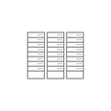
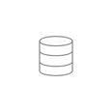
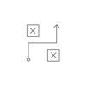
Containers + Kubernetes is how cloud native happens
95%
81%
OF NEW APPS
OF ENTERPRISES
are developed in containers.
work with 2+ public cloud providers.
DATA APPS
NEW PEOPLE & PROCESS
APP-DRIVEN AUTOMATION
DevOps
Containers
GitOps
78%
85%
MULTI-CLOUD INFRASTRUCTURE
Data
Pipelines
OF CNCF MEMBERS
OF GLOBAL BUSINESSES
use Kubernetes in production.
will be running containers in production by 2025 (up from 35% in 2019).

Slide 4
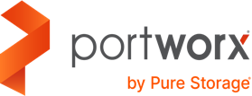
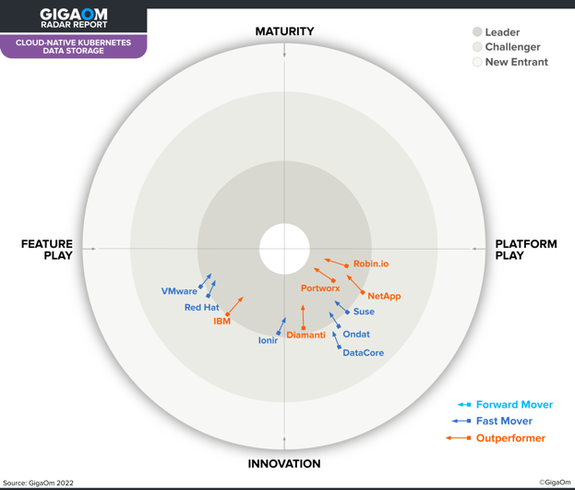
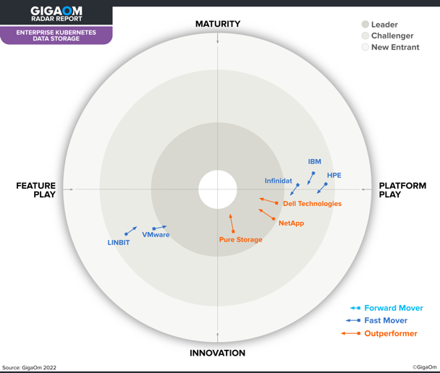
#1 in Kubernetes Storage for 3 years in a row!!!
#1 in Cloud Native Kubernetes Data Storage
#1 in Enterprise Kubernetes Data Storage
GigaOm Radar for Cloud-Native Kubernetes Data Storage, 2022
GigaOm Radar for Enterprise Kubernetes Data Storage, 2022
Notes:
Short version-
Portworx by Pure Storage remands the “gold standard” in Kubernetes Storage according to GigaOm Research for 3 years in a row.
According to the GigaOm Radar Report for Cloud-Native Kubernetes Storage, Portworx® by Pure Storage “is one of the most advanced solutions for enterprise Kubernetes storage” and “remains the gold standard in cloud-native Kubernetes storage for the enterprise” as “a complete enterprise-grade solution with outstanding data management capabilities, unmatched deployment possibilities, and superior management features.
Additionally, thanks to Portworx, Pure Storage leads the “Enterprise Kubernetes data storage” category which looks at enterprise storage solutions like Pure FlashArray and their support for containers. In GigaOm’s words “Pure Storage uses its cloud-native storage solution, Portworx, to unlock Kubernetes support for its enterprise storage products, FlashArray and FlashBlade”. So regardless of your infrastructure, picking Portworx means you are picking the market leader.

Slide 5
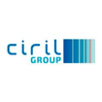
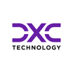
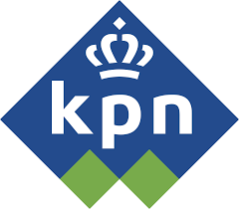
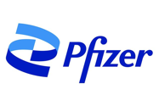
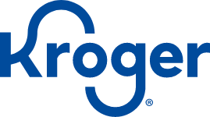
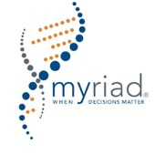
Portworx Wins Across Industries
Financial Services Industry (FSI)
Technology, Media, Telecom (TMT)
Manufacturing & Automotive
Healthcare
Retail
Government / Education

Slide 6
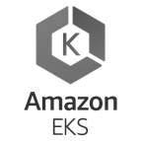
One single platform for any app, anywhere
Any App
Any Distribution
DATABASE
ANALYTICS
STREAMING
SEARCH/LOG
5G/IoT
AI/ML
GKE
AKS
Tanzu
The industry’s leading Kubernetes Data Services Platform for building, automating, protecting, and securing Cloud Native applications.
Any Cloud
Any Infrastructure
Every Stage
Pilot
Test/
Dev
Go Live
Global CaaS
Bare Metal

Slide 7
Complete protection with no hardware dependencies
Any App
Any Distribution
The Kubernetes Data Platform
SDS storage layer that automates container storage for developers and admins
Consistent storage APIs: cloud, bare metal, or arrays
Auto-scale storage as your app grows to reduce costs
GitOps-driven automation so app teams don’t have to worry about infrastructure
Sync and async replication between AZs and regions
Zero RPO active/active for the highest resiliency
PX-Store
PX-Autopilot
PX-DR
Easily move applications between clusters
Enables hybrid cloud and multicloud mobility
Implement consistent encryption and security policies across clouds
Enable multi-tenancy with access controls
App-consistent backup for cloud native apps with all k8s artifacts and state
Backup to any cloud or on-prem object storage
PX-Migrate
PX-Secure
PX-Backup
Any Cloud
Any Infrastructure
Every Stage
Notes:
Let’s explore the Portworx platform in a little more detail.
First comes PX-Store: Built from the ground up for containers, PX-Store provides cloud native storage for app running in the cloud, on-prem, and in hybrid/multi-cloud environments. It provides container-optimized volumes with elastic scaling to prevent application downtime, and High Availability across nodes/racks/AZs so you can failover in seconds.
PX-Backup: PX-Backup allows you to capture entire Kubernetes applications at the click of a button move them to any backup location. Recover entire applications just as easily.
PX-DR: PX-DR extends the data protection included in PX-Store and PX-Backup with Zero data loss Disaster Recovery for data centers in a metropolitan area as well as continuous backups across wide area networks for an even greater level of protection.
PX-Migrate: Allows you to easily move entire applications across clusters, racks, and clouds.
PX-Secure: provides container-granular encryption and access controls, you can move securely even at the speed of Kubernetes.
Finally
PX-Autopilot: PX-Autopilot for Capacity Management allows you to stop over-provisioning storage capacity in the cloud so you can cut your cloud storage bill in half.

Slide 8
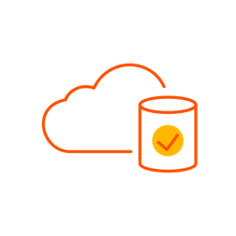
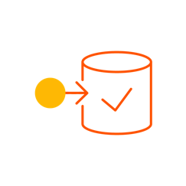
App-granular backup and restore to any cloud
AWS
App 1
App 2
On prem
1.K8s objects
2.Config
3.Data
AWS S3
Backup
Restore
Central archive
Azure
App 1
App 2
Azure blob store
Notes:
So whereas before, we saw that traditional backup doesn’t provide application aware protection for Kubernetes, PX-Backup does. You can backup any app running on Kubernetes at the pod, tag, or namespace level and back it up to any object storage. Then you can recover just as easily to any Kubernetes cluster running in any environment.

Slide 9
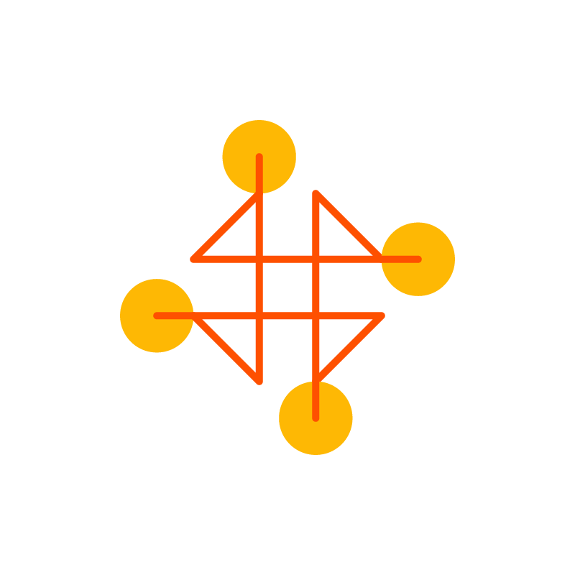
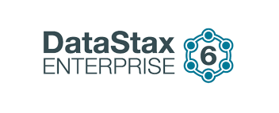
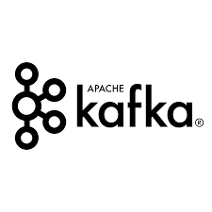
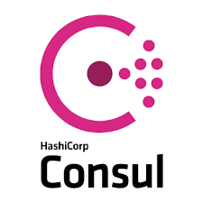
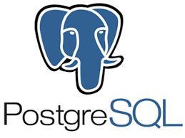
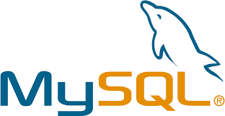
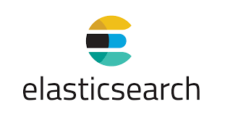
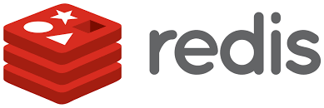
Modern apps run on modern data services
Heterogeneous data services
Database
Analytics
Search
AI/ML
Streaming
Notes:
Enterprises run on data. But the databases that we use in the enterprise have changed. Gone are the days of putting everything in Microsoft SQL Server or Oracle. Modern microservices, like those that run on Kubernetes, aren’t supported by a single database anymore. The developers leveraging your Kubernetes platform are running databases, analytics, search, streaming, and AI/ML workloads. Each of these solutions has its own patterns for deployments, data protection, security and more.

Slide 10
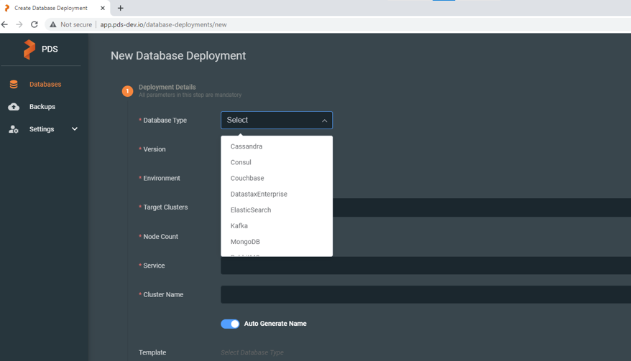
Introducing Portworx
Data Services
Database-as-a-service Platform for Kubernetes
Broadest range of data services
Run on any infrastructure
Notes:
Portworx Data Services is the industry’s first Database-as-a-Service Platform for Kubernetes. With the click of a button, DevOps engineers can deploy a managed, production-grade data service on Kubernetes from the industry’s broadest catalog of options for SQL, NoSQL, search, streaming, and more. PDS fully automates Day-2 operations, including monitoring, backups, HA, DR, migration, auto-scaling, and security. With Portworx Data Services, running data services on Kubernetes on any infrastructure is dramatically simpler than other approaches.

Slide 11
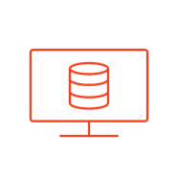
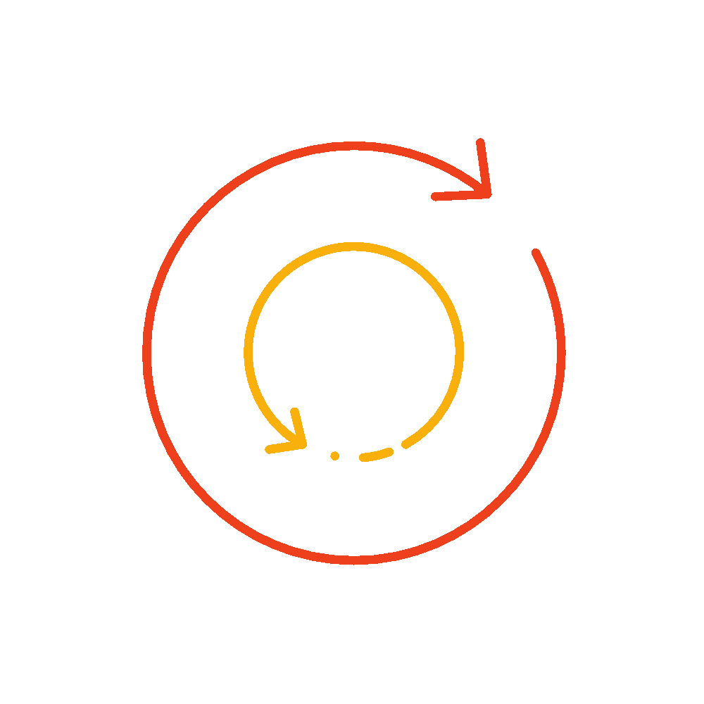
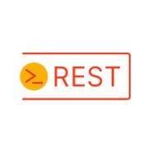
PDS Delivers DBaaS on Any K8S infrastructure
1 click- Database Deployments
Curated Templates for Database sizing
Scheduled Backup Policies
Application Aware Backup and Restore
API Driven or use the UI
Sample Databases offered over time
Built on
Store
Backup
DR
Migrate
Secure
Autopilot
Notes:
PDS is built upon Portworx Kubernetes storage and data management so you know it scales to support high end enterprise requirements. Importantly it’s agnostic, just like Portworx meaning it runs in any Kubernetes and infrastructure environment. It also means that HA, data protection, data mobility and data security are solved out of the box.
In the future it will offer the broadest catalog of options including SQL and NoSQL databases, search, streaming and more.
As I’ve said for each data service, you get one-click database deployments that include curated templates for database sizing so you don’t have to be an expert to run a production-grade data service. You get configurable backup policies that happen at the application granular level. And you can use PDS either via the SaaS user interface, or program against it using the API.

Slide 12
Build faster, more reliable apps. Anywhere.
The case for change
Why Now
Digital leaders are using the Cloud Native Stack to meet these challenges head-on.
DATA APPS
NEW PEOPLE & PROCESS
SPEED IMPERATIVE
25X faster recovery by high-performing DevOps teams
APP-DRIVEN AUTOMATION
Containers
GitOps
Source:Puppet State of DevOps
MULTI-CLOUD INFRASTRUCTURE
DATA EXPLOSION
Why Portworx
6 BILLION connected individuals by 2025
Source: IDC Data Age 2025
Any App
Any Distribution
The Kubernetes Data Services Platform
SECURITY THREAT
Sync and async replication between AZs and regions
Zero RPO active/active for the highest resiliency
600% increase in annual data breaches in last decade
PX-Store
PX-Backup
PX-DR
The industry’s leading Kubernetes Data Services Platform for building, automating, protecting, and securing Cloud Native applications.
Source: ITRC Breach Statistics 2006-2016
PX-Migrate
PX-Secure
PX-Autopilot
Any Cloud
Any Infrastructure
Every Stage

Slide 13
Thank You !
Ufuk Önder
Senior Systems Engineer
ufuk@purestorage.com

