Slide 1
WDC Ultrastar for Ceph Storage Solutions
October 11 2022
Manfred Berger Sr. Mgr. Business Development Platforms EMEAI
October 11 2022

Slide 2
SAFE HARBOR STATEMENT
This presentation contains forward-looking statements that involve risks and uncertainties, including, but not limited to, statements regarding our product and technology portfolio; upcoming flash product releases; data growth and its drivers; business strategies and growth opportunities; and market growth and industry trends. Forward-looking statements should not be read as a guarantee of future performance or results and will not necessarily be accurate indications of the times at, or by, which such performance or results will be achieved, if at all. Forward-looking statements are subject to risks and uncertainties that could cause actual performance or results to differ materially from those expressed in or suggested by the forward-looking statements.

Slide 3
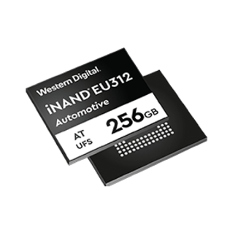
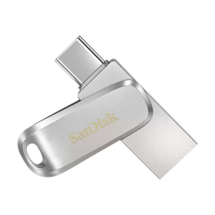
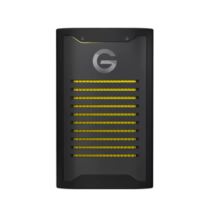
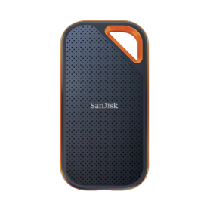
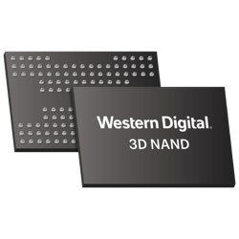
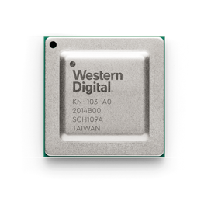
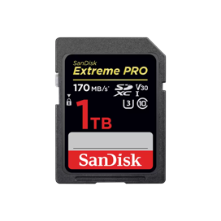
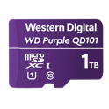
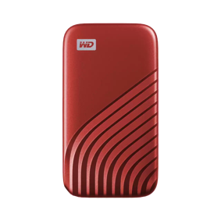
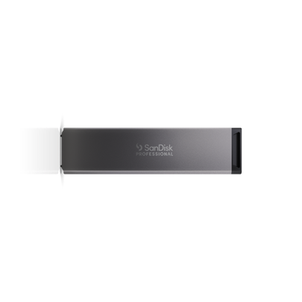
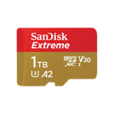
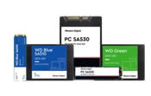
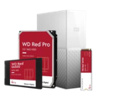
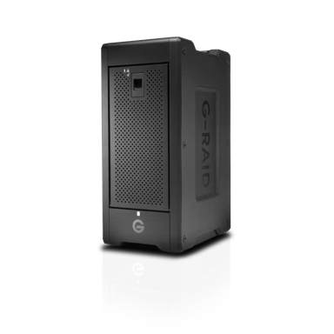

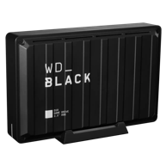
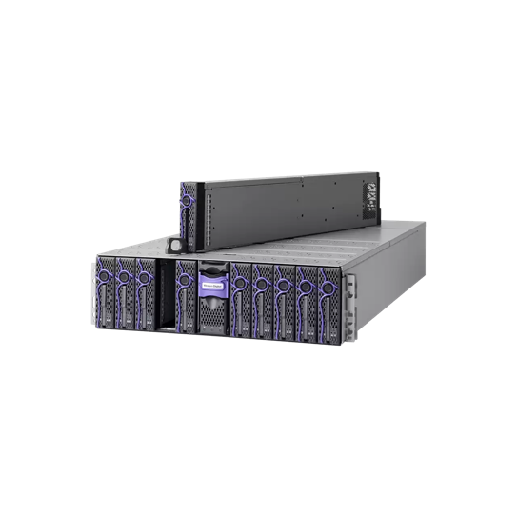
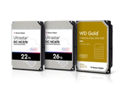
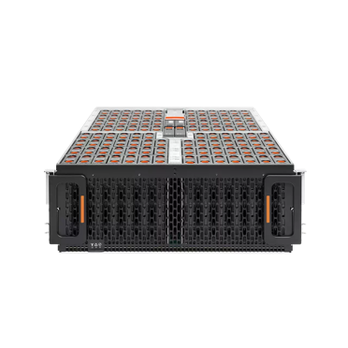
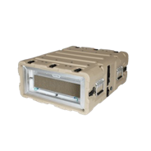


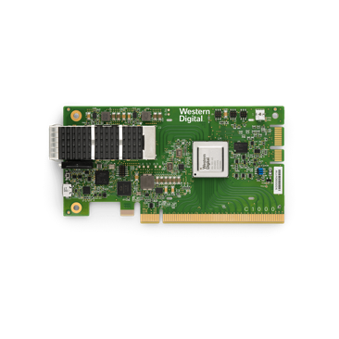
THE BROADEST STORAGE LEADERSHIP
NAND COMPONENTS
EMBEDDED
NAND
NVMe-OVER-FABRIC BRIDGE ASIC
MEMORY
CARDS
USB
DRIVE
PORTABLE
STORAGE
CLIENT
SSD
CLIENT
HDD
NAS &
PERSONAL CLOUD
DIRECT-ATTACHED
STORAGE
DATA CENTER
HDD
DATA CENTER
SSD
JBOD &
JBOF
STORAGE
SERVER
NVMe-OVER-FABRIC BRIDGE ADAPTER
OPENFLEX™
NVMe-OVER-FABRIC STORAGE

Slide 4
Ultrastar TM
HDD Portfolio

Slide 5
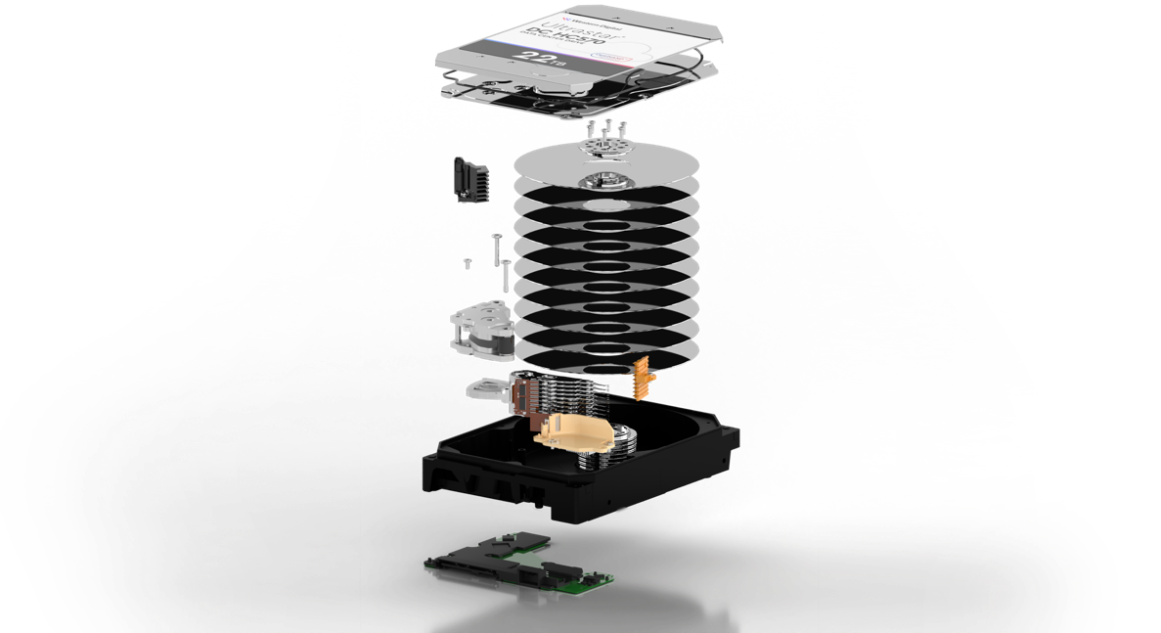
Technology Building Blocks
Helium Seal
Recording Format
CMR | SMR | UltraSMR
Magnetic Media
Ultra-Thin AlMg Substrates
Micro-Positioning
Single Stage | Dual Stage | Triple Stage Actuation
Recording Heads
PMR | ePMR
Access Density
1 Head Active at a Time | 2 Heads Active
SOC and Flash
DRAM Only | DRAM + OptiNAND

Slide 6
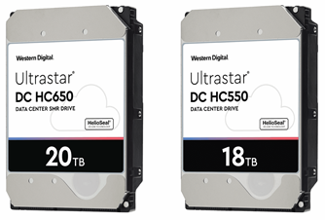
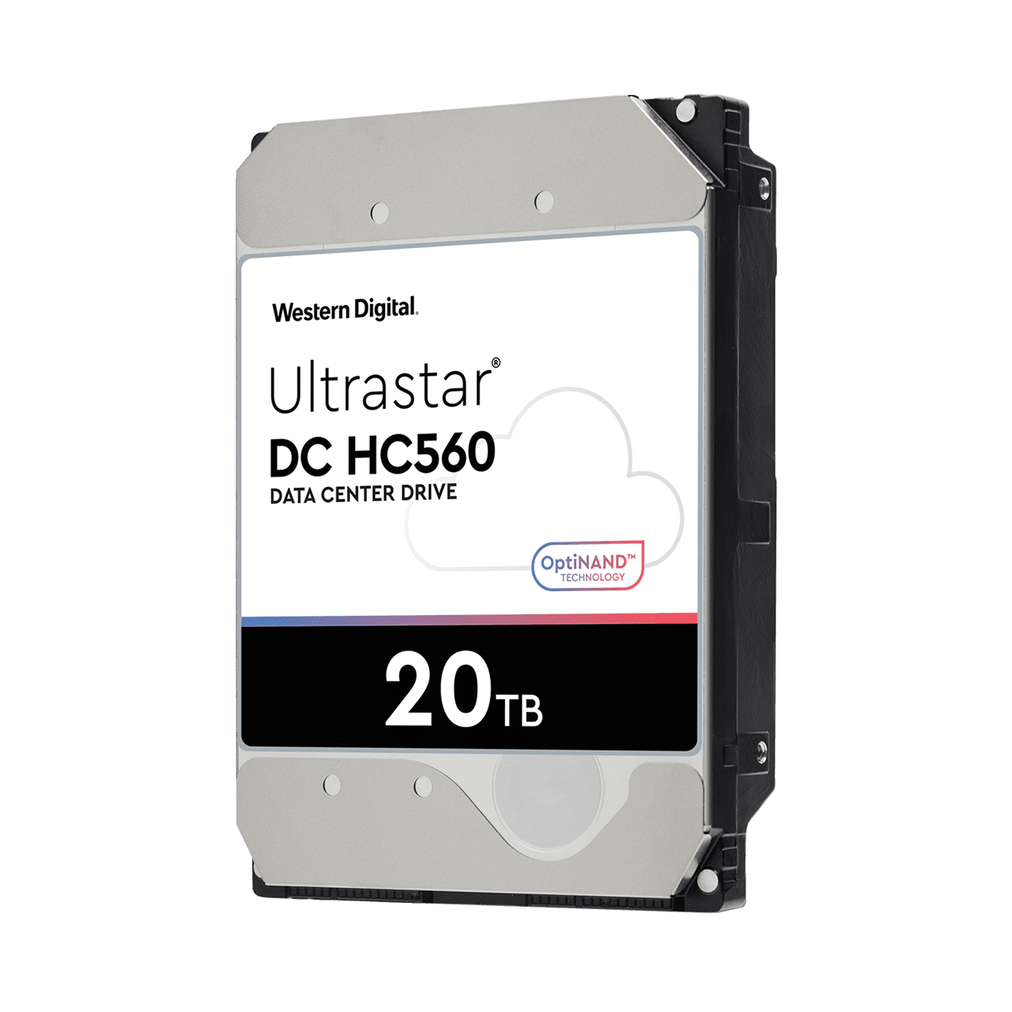
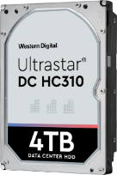
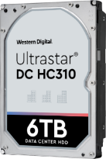
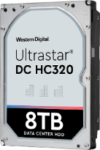
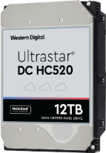
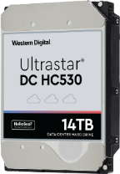
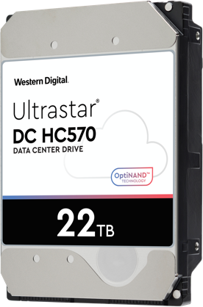
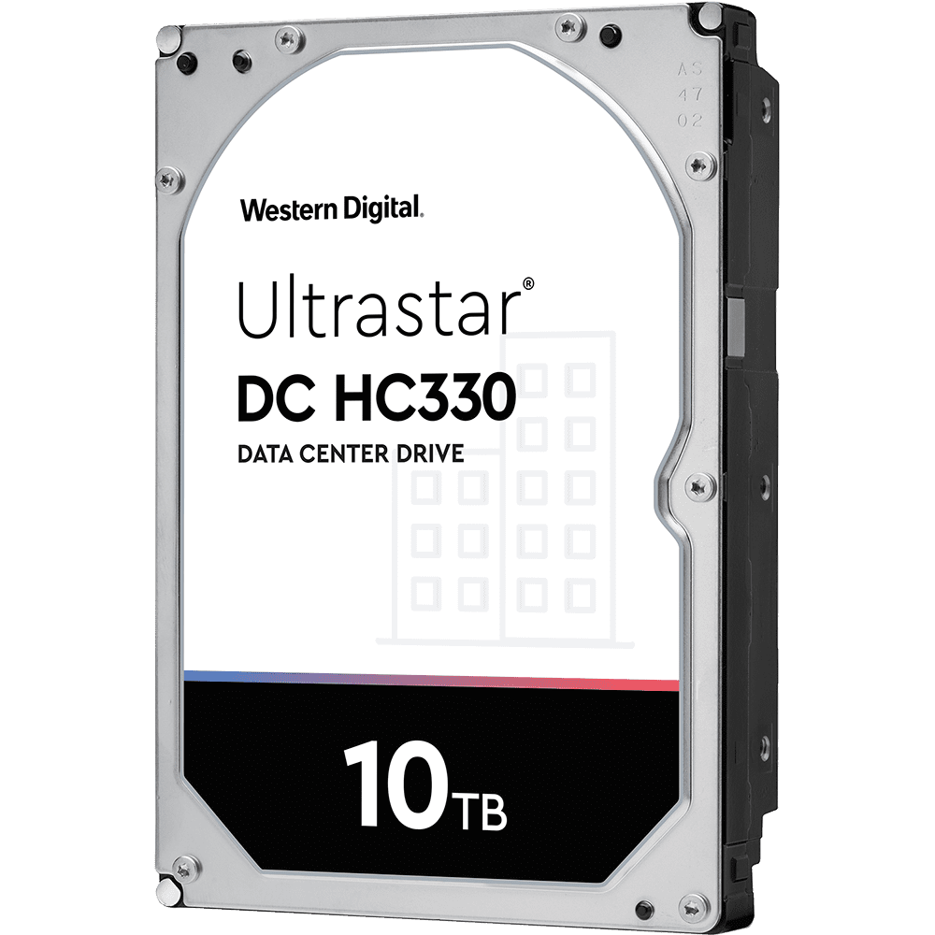
Highest IOPS density
Lowest Power Consumption
Highest Storage Density
Air PMR/CMR
Helium PMR/CMR
Helium EAMR PMR/CMR + SMR
Ultrastar®
DC HC310/320/330
Ultrastar®
DC HC520/530
Ultrastar®
DC HC650 550/560/570 *)
12Gb SAS/6Gb SATA
7200 RPM
4, 6, 8, 10 TB
3.5” LFF
12Gb SAS/6Gb SATA
7200 RPM
12, 14 TB
3.5” LFF
12Gb SAS/6Gb SATA
7200 RPM
20 TB SMR, 26 TB in prep.
14/16/18, 20, 22 TB CMR
3.5” LFF
*) DC HC 570 22TB SAS/SATA presently in Qualification with Ultrastar Platforms

Slide 7
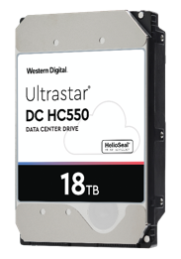
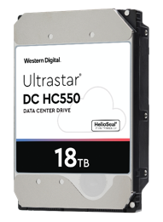

C- and D-Generation
Family Overview
SINGLE ACTUATOR
Product Comparison | Product Comparison | DC HC550 | DC HC560 | DC HC570*
Interface | Interface | SAS 12G / SATA 6G | SAS 12G / SATA 6G | SAS 12G / SATA 6G
Capacity | Capacity | 16TB &18TB CMR | 20TB CMR | 22TB CMR 26TB SMR
Disks | Disks | 9 | 9 | 10
Power (Rnd R 4KB QD8) | Power | 9.5W / 9.2W | 9.6W / 9.5W | 10W / 9.8W
Cache Technology |  | DRAM, Media Cache | DRAM, Media Cache OptiNAND | DRAM, Media Cache ArmorCache
PERFORMANCE | Sequential (max) | 257 MiB/s | 278 MiB/s | 278 MiB/s (CMR) 238 MiB/s (SMR)
 | Random Read 1MiB (WCD QD1 / 32) | 87 / 210 IOPs | 88 / 212 IOPs | ← (CMR) 84 / 198 IOPs (SMR)
 | Random Write 4K (WCE/WCD QD1, 32) | 445, 445 IOPs | 565, 565 IOPs | ←
Reliability | Reliability | 2.5M MTBF, UBER: <1 in 10¹⁵ | ← | ←
Op Shock (g, @2ms read, write) Non-Op Shock (g, @2ms) | Op Sock (g, @2ms read,write), Non-Op Shock (g, @2ms) | 50 / 50 250 | ← | 40 / 40 200
D-GEN CAPACITY ENABLERS
OptiNAND™ technology uses enhanced FW to increase track following precision
ArmorCache™ improves performance and provides enterprise power loss protection.
UltraSMR provides extra SMR capacity with improved error correction
Triple-Stage Actuator improves TPI capability with more precise actuator arm control
ePMR increases Areal Density with more precise recording head technology
*PRELIMINARY DATA – SUBJECT TO CHANGE WITHOUT NOTICE
Notes:
ArmorCache™ improves performance and provides enterprise power loss protection:

Slide 8

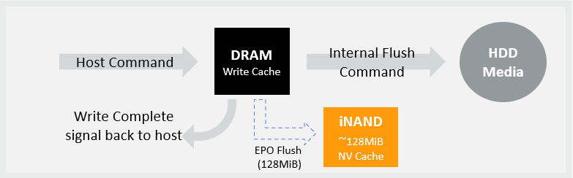
ArmorCache™ on Ultrastar
Write cache data safety feature, enabled by OptiNAND ™
Enables enterprise Power Loss Protection in WCE mode, and higher performance in WCD mode.
Entire user portion of DRAM is successfully flushed to iNAND upon EPO, whether in WCE or WCD mode
User realizes benefits of both modes, regardless of which cache mode is chosen
 | WCE Mode |  | WCD Mode
 | Performance | Power Loss | Performance | Power Loss
Prior drives | High | Data at risk | Lower | Data is safe
Ultrastar DC HC570 | High | Data is safe | High | Data is safe
Notes:
See: Brad Warbiany for details.

Slide 9
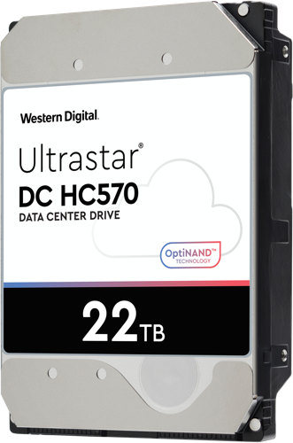
Performance Gains on 22TB platform
With ArmorCache feature
Increased Write Cache Disabled (WCD) performance
Significant advantage at HDD-relevant larger transfer length

Slide 10
Performance Gains on 22TB platform
With ArmorCache feature

Slide 11
Ultrastar TM
Platform Portfolio

Slide 12

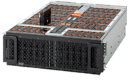
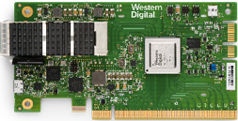
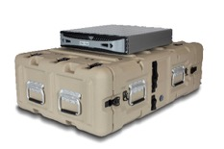
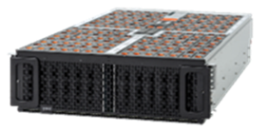
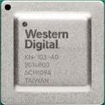

Platforms Portfolio
High Capacity, Performance and Flexibility
Specialized Servers
External HDD
Fabric Attached
Data Transport and
Ruggedized/Mil-Spec Edge Servers
High-density JBODs
NVMe-oF attached JBOF
Fabric Bridge Devices
Ultrastar®
OpenFlex™
RapidFlex™
Solutions to access, transform, transport and preserve data

Slide 13
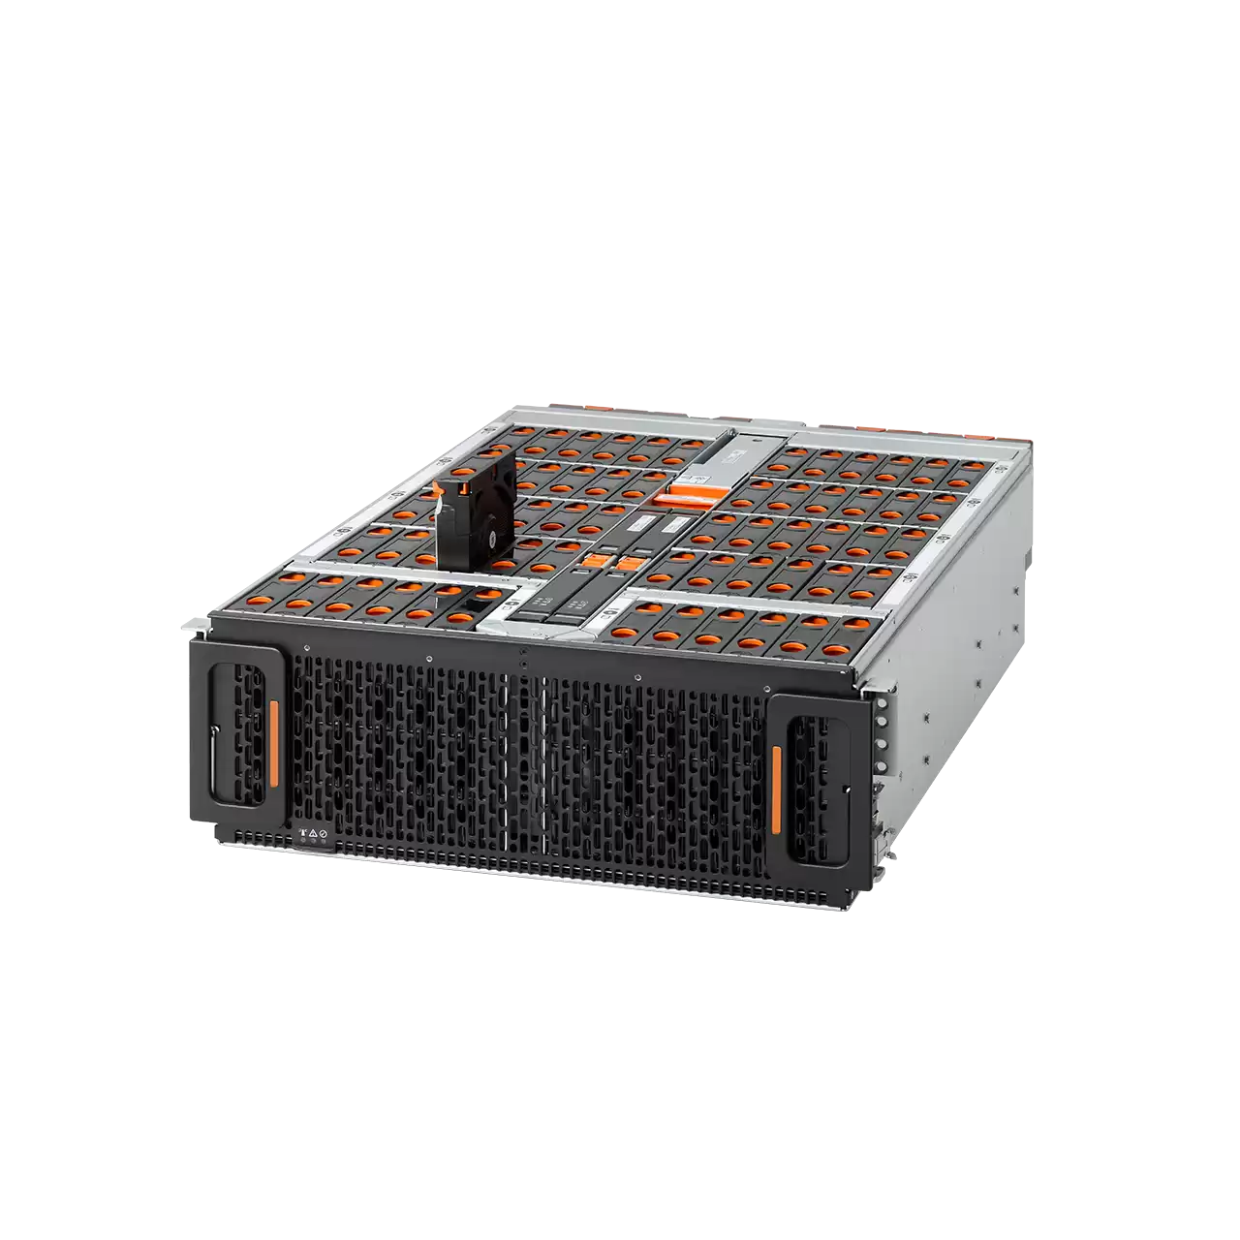
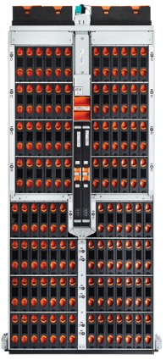
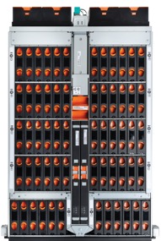
Ultrastar® Data60/102 Storage Platform
4U 60-bay and 4U 102-bay JBOD family:
  Compact 4U60 with depth requirement of <890mm
  Dense 4U102 with over 2.2PB in 4U (22TB CMR HDDs)
  Backed by a 5-year limited warranty with advance replacement
Enterprise grade, big data storage use cases
  Backup, archive, surveillance,
  Disaggregated storage for SDS environments

Slide 14
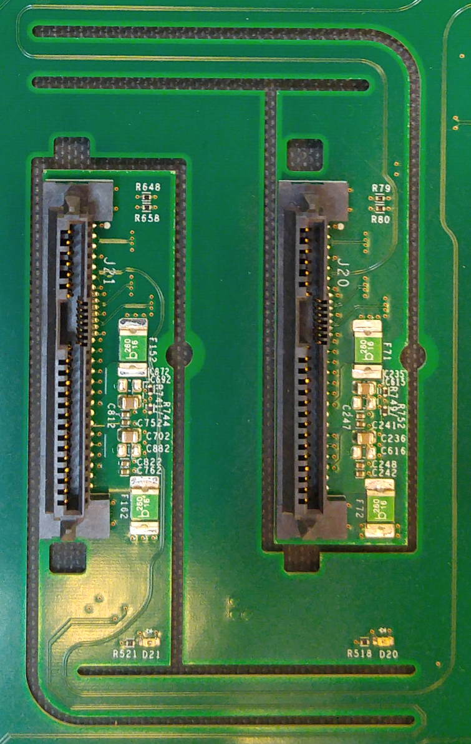
Ultrastar Data Family Innovation IsoVibe™
IsoVibe patented vibration isolation technology
  Vibration Isolated HDD carrier/slot & fans
  Over 60% lower vibration
  Stable Performance even under heavy load
  IsoVibe™
  Less Vibration
  Less Crosstalk
  Stable Performance

Slide 15
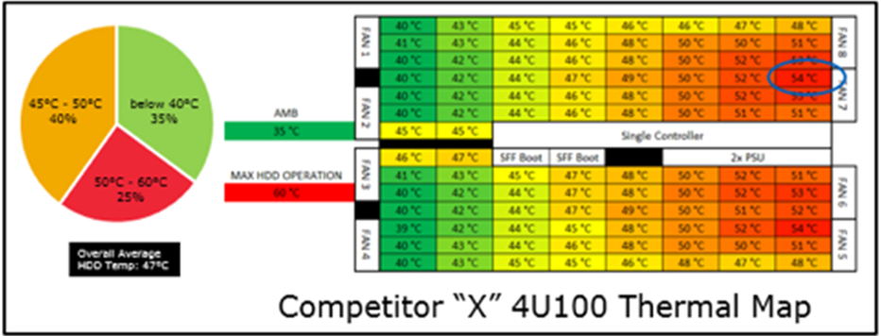
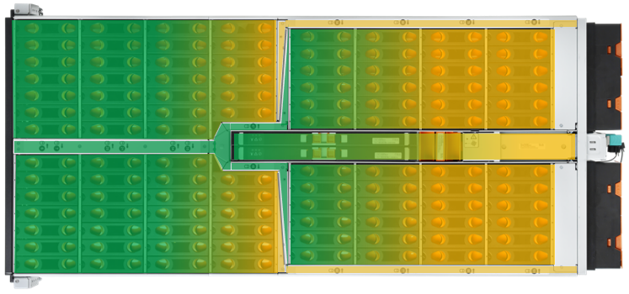
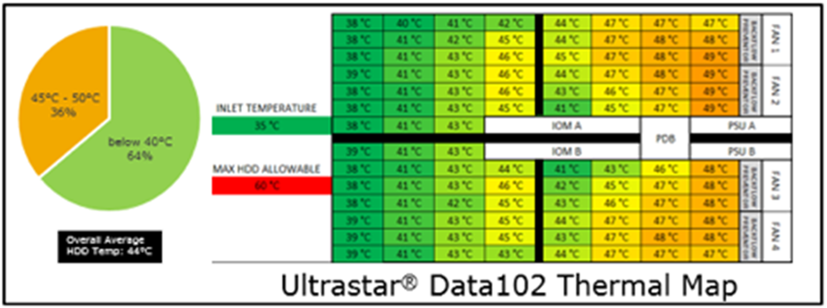
Ultrastar Data Family Innovation ArcticFlow ™
ArcticFlow thermal zone cooling technology
  Lower temperature, tighter thermal spread
  Improved reliability
  Overall energy saving

Slide 16

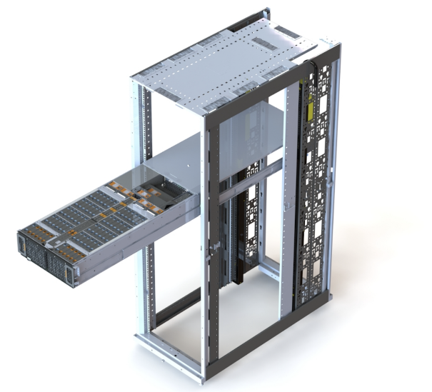


Ultrastar Data Family Serviceability
Cold Aisle Service
  Center /CPU Fan (JBOD or Serv60+8)
  SSDs (Serv60+8 only)
  IO-Module (ESM)
  HDDs & SSDs
General Handling
  Lid stays inside rack
  Handles unlatch unit to pull out
  No tools required
  Chassis status indicated by front LED
  HDD/SSD status indicated by LED(s)
Front = Cold Aisle
Back = Hot Aisle

Slide 17
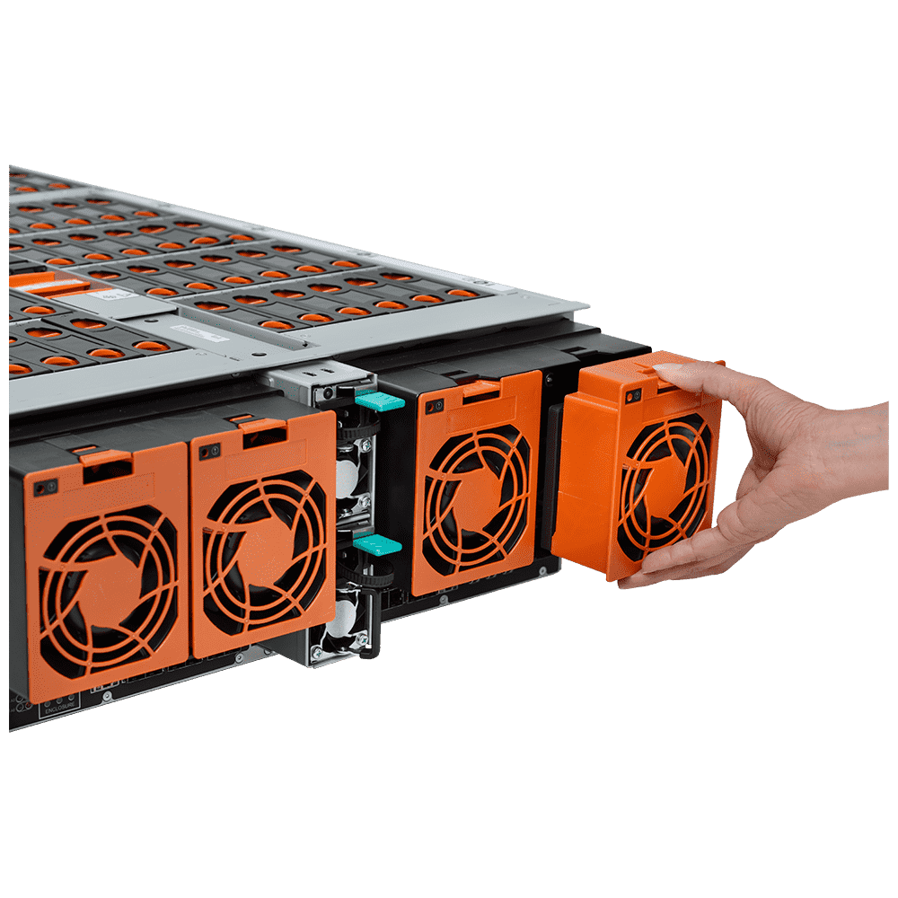
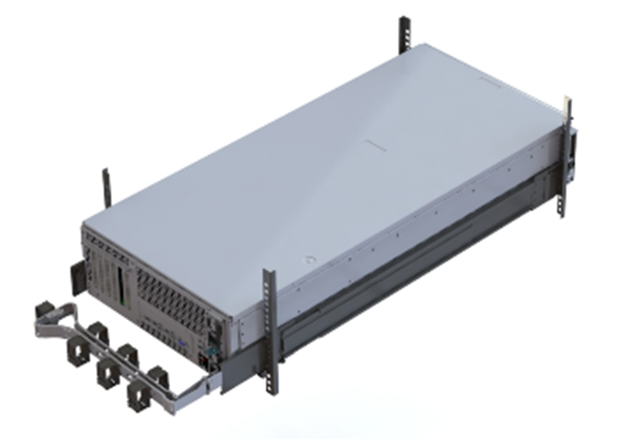
Ultrastar Data Family Serviceability
Hot Aisle Service
External Blowers
PSUs (1 + 1 redundant)
SAS Ports 2 x 6 (SAS) or 1 x 6 (SATA)
Hot Aisle Service
CMA (pivots away)
Cables are secured when unit gets pulled

Slide 18
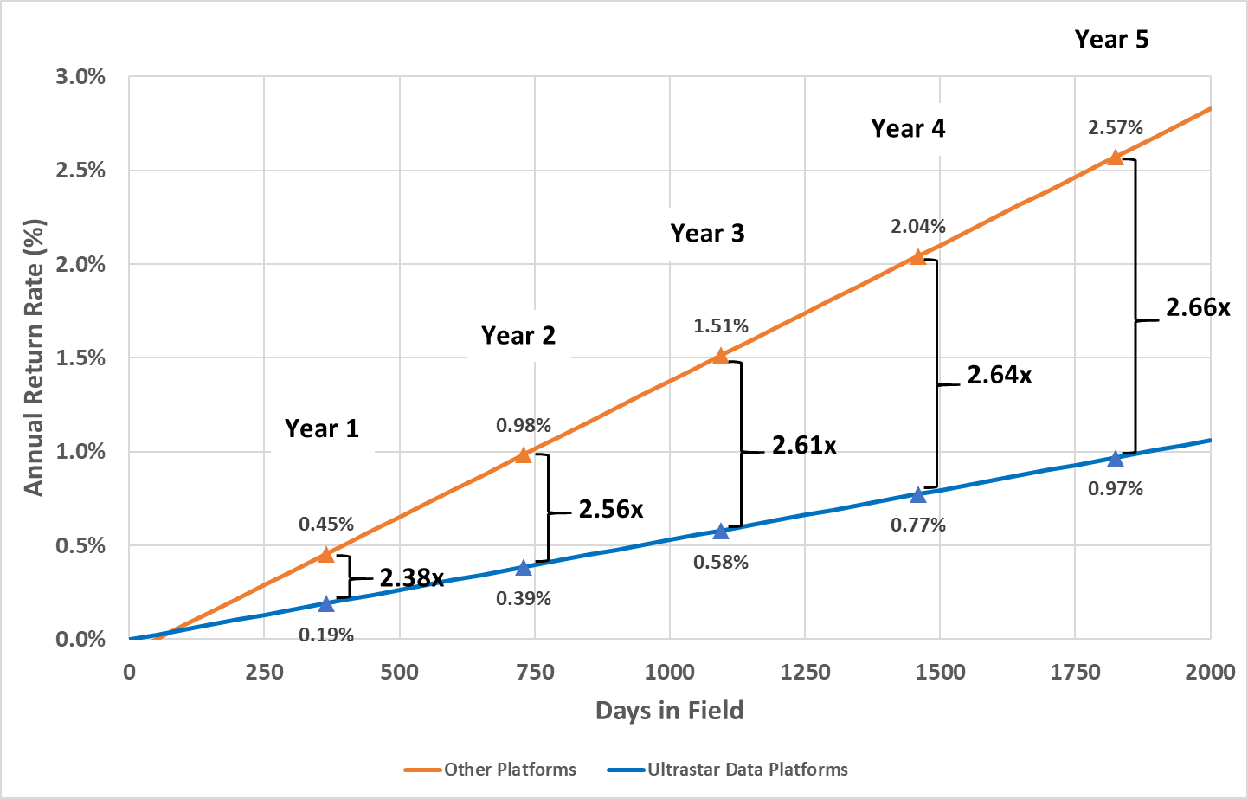
Ultrastar Data Family Innovations
Reduction of 62% in drive return rate*
  Same HDD Ultrastar DC HC520
    Ultrastar Data vs. JBOD w/o IsoVibe & ArcticFlow
  Fewer false alarms by thermal throttling
  Fewer false alarms by vibration induced time outs
Based on observed drive return data, does not change product specifications and does not constitute a warranty
ARR = Annual Return Rate, including false alarms
AFR = Annual Failure Rate

Slide 19
Published HDD 2Q22 Return Rates
WDC/HGST 3,981,929 Drive Days 76 Returns = 0.64% ARR
Competitor A 9,563,552 Drive Days 547 Returns = 2,09% ARR
Competitor B 4,376,053 Drive Days 140 Returns = 1,17% ARR
Data Source: https://www.backblaze.com/blog/backblaze-drive-stats-for-q2-2022/

Slide 20

Ultrastar JBOD Versatility
Key Features (1.67PB in 14U)
6x 1U Servers
  24+ Cores each
  64GB of RAM
  2x Dual Port HBA
  Optional SSD Caching
2x Ultrastar Data60 JBOD
  60x 22TB SAS HDD
  Shared 2x10 per Server
    T10 Zoning
  Redundant IOMs / Data Paths
  Redundant PSUs
18/6 Erasure Coding
  1,670TB net storage
  Any two Servers may fail
  Up to 7 HBAs may fail
  Any 6 HDDs may fail
  Up to 4 fans may fail
  Up to 2 PSUs may fail
  Up to 2 IOMs may fail

Slide 21

OpenFlex™ Data24 NVMe-oF JBOF
Options & Upcoming Enhancements
6x 100 Gbps Ethernet RoCE connectivity
  NVMe/TCP Support coming 1CQ 2023
  96 or 192 shared name spaces
2x 100 Gbps, single RapidFlex card per IOM
  Enables easy replacement of SAS environments
  Allows each port to see all 24 drives
Support for Open Composable API
  Management commands thru CLI and GUI
  Simplified management through out-of-band port

Slide 22





RapidFlex™ High-Performance NVMe-oF Controller
ASIC and HBA
A1000/C1000
An optimized NVMe-oF target JBOF solution
  Extremely low power, minimal latency penalty
Advanced levels of hardware acceleration
Enables efficient compute/storage disaggregation
  DAS-like performance with all the benefits of composability
Available as 21mm BGA packaged target ASIC or compact PCIe target adapter card
100Gb Ethernet connectivity
A2000/C2000
Feature Additions to A1000/C1000
  NVMe-oF initiator capability
  RoCE2 & NVMe-over-TCP
  Second 100 GbE port (Dual Port Initiator)
  PCIe Gen4 x16
  Increased Ethernet connection support
  Non-Transparent Bridging (PCIe switch feature)
Sampling: CQ4 2022 / Production: CQ1 2023
Notes:
NTB enables any ethernet port to access any SSD vs. fixed mappings in Fuji

Slide 23

Ceph*) on Steroids
Small/Test Configuration:
1-6x cluster nodes (QuantaStor 5.8.4)
Mellanox MCX516A-CDAT
6x client servers (Ubuntu 18.04)
Mellanox MCX516A-CDAT
1x Mellanox SN2700 (OPFC, ECN)
1x Data24 Chassis
Benchmark Summary:
19.42 GB/s @ 64MB Gets
9.49 GB/s @ 64MB Puts
1,488 IOPS @ 4MB 50%R/50%W
*) OSNexus QuantaStor 5

