Slide 1
Dell Technologies Advantage Build Your Breakthrough
Feyza Başaran
Principal Partner Systems Engineer

Slide 2
Every organization must be a digital organization
Digital Laggards
Do not have a digital plan; limited initiatives & investments in place
Digital Followers
Very few digital investments; tentatively planning for the future
Digital Evaluators
Gradually embracing digital transformation & planning for the future
Digital Adopters
Have a mature digital plan, investments & innovations in place
Digital Leaders
Digital transformation is ingrained in the DNA of the business
2016
2018
2020
15%
9%
3%
32%
30%
13%
34%
33%
39%
14%
23%
39%
5%
5%
6%
© Copyright 2019 Dell Inc.

Slide 3
Challenges in the do-from-anywhere economy
Animated Build Slide
Customization Options
To advance in an evolving, hyper-digital world, you need the right technology, skills and culture to embrace change.
FEAR OF BEING LEFT BEHIND
51%
worry the opportunity to become a data-driven business will pass them by.
INCREASING ATTACK SURFACE
72%
acknowledge that given the ever-evolving nature of work, their organization would be even more exposed to cyberattacks.
TECHNOLOGY TOO CENTRALIZED
52%
say they might be left behind because they don’t have the right technology to shift to a hyper-distributed model.
BREAKTHROUGH STUDY
Global survey of 10,500 leaders and knowledge workers on their readiness to embrace digital change in the do-from-anywhere economy.
Source: Dell Technologies: The Breakthrough Study, April 2022; 10,500 respondents globally.
dell.com/breakthrough

Slide 4
Be ready for whatever’s next
With our software-driven storage innovation

Slide 5
89%
report autonomous operations are either critical or their most important priority in next two years¹
We live in an ever-changing world…
63%
have been the target of ransomware in the last 12 months³
79%
will modernize over the next 3 years to build out better multicloud interoperability²
1 n=1,100, Dell Technologies IT Automation Research Survey, IDC, September 2021. 2 ESG Complete Survey Results, Distributed Cloud Series: Application Infrastructure Modernization Trends, March 2022.
3 ESG Research Report, 2022 Technology Spending Intentions Survey, November 2021.
5
Copyright © Dell Inc. All Rights Reserved.

Slide 6
Organizations want to innovate with data, but...
Operational silos
Cloud complexity
headwinds prevail.
Developer
productivity
Cyber threats
6
Copyright © Dell Inc. All Rights Reserved.

Slide 7
Turn headwinds into tailwinds.
AUTOMATE IT operations
Innovate more
SECURELY
Gain MULTICLOUD CONTROL and mobility
Boost productivity, reduce risk, be ready for what comes next
Invest with confidence, make business breakthroughs possible
Get more value from information – wherever it lives
Accelerate time between data creation and innovation.
7
Copyright © Dell Inc. All Rights Reserved.

Slide 8
Our software-driven innovation…
Delivers a continuously modern storage experience
Adaptable software architectures
Comprehensive
cyber resiliency
Multicloud ecosystem flexibility
8
Copyright © Dell Inc. All Rights Reserved.

Slide 9
Adaptable software architectures
Boost productivity
3X faster
Eliminate time-consuming tasks with ML.
time to resolution and 16 hours saved per week, CloudIQ frees us to spend more time on performance tuning and on R&D for new products.
Operate infrastructure with cloud-like agility.
Resolve issues with intelligent insights.
Darrel Schueneman
Manager, Cloud Operations
Plex Systems
9

Slide 10
Adaptable software architectures
Automate IT Operations with intelligent insights end-to-end
Off-premises/ Clouds
On-premises/ Private Cloud
UP TO 99%
UP TO 10x
time-consuming tasks eliminated
faster time- to-resolution
70%
productivity boost
99% Based on Dell analysis of staff time required to maintain balanced PowerStore cluster vs. traditional multi-array deployment, March 2020. Factors in effort required to monitor, plan, define and execute volume migrations. Actual results will vary.
Principled Technologies lab report ​Based on an April 2020 Principled Technologies Report commissioned by Dell EMC, "Dell EMC CloudIQ streamlined the user experience in five cloud-based storage preventative management tasks”.
IDC Business Value Snapshot for PowerFlex 2020.
10

Slide 11
Comprehensive cyber resiliency
Make business breakthroughs possible.
Protect data and operations wherever they are.
Mission Critical
&
Secure
Overcome security complexity.
Respond and recover with confidence.
11

Slide 12
Comprehensive cyber resiliency
Innovate securely with innovative software
Off-premises/ Clouds
On-premises/ Private Cloud
Dell serves
of Fortune 500 companies
Find data corruption
with up to
95%
96%
confidence
Dell Technologies Key Facts, updated March 2022.
12
Copyright © Dell Inc. All Rights Reserved.

Slide 13
Multicloud ecosystem flexibility
Get more value from data – wherever it lives.
In storage software,¹ NAS,² Unstructured Storage,² Hyperconverged Systems,³ External Enterprise Storage Systems,² Data Replication & Protection Software⁴ and Data Protection Appliance & Software⁵
Use any data in your clouds.
#1
Manage containers, not infrastructure.
Get enterprise-scale and a consistent experience.
1 IDC WW Quarterly Enterprise Storage Systems Tracker, 2021Q2, September 9, 2021, Vendor Revenue.
2 IDC WW Quarterly Storage Software & Cloud Services QView, 2021Q2, September 9, 2021, Vendor Revenue.
3 IDC WW Quarterly Converged Systems Tracker, 2021Q2, September 16, 2021, Vendor Revenue.
4 IDC 1Q21 Storage Software and Cloud Services Qview.
5 Based on combined revenue from the IDC 1Q21 Purpose-Built Backup Appliance (PBBA) Tracker, with select Storage Software segments from the 1Q21 Storage Software and Cloud Services Qview.
6 IDC WW Quarterly Purpose-Built Backup Appliance Tracker, 2021Q2, September 9, 2021, Vendor Revenue.
Note: Unstructured Storage includes object-based storage (excluding HCI) and Scale-Out NAS (excluding HCI) combined.
13

Slide 14
Multicloud ecosystem flexibility
Gain multicloud control with cloud-enabled software
Off-premises/ Clouds
On-premises/ Private Cloud
Broadest enterprise product portfolio from a single vendor supporting all major hyperscalers
Dell internal analysis, March 2022
UP TO 80%
cost reduction p/GB for archive & long-term data retention
10EB
of data
in the cloud
Based on Third Party Analysis, commissioned by Dell Technologies "Understanding the Economics of In-cloud Data Protection" September 2021.
Assumes 4:1 average data reduction. Actual results may vary, depending on data types.
14
Copyright © Dell Inc. All Rights Reserved.

Slide 15
What’s next?
Discover the power of our portfolio…
15
Copyright © Dell Inc. All Rights Reserved.

Slide 16
Rise of Containers
2019
2025
54% of container instances will be deployed primarily in the datacenter by 2023.¹
85% of global organizations will be running containerized applications in production 2025.²
By 2025, nearly two-thirds of enterprise will be prolific software producers with code deployed daily.
Source:
IDC Container Infrastructure Software Market Assessment, April, 2020
IDC WW Semiannual IT Spending Guide: Line of Business, April 2018
Gartner CTOs Guide to Containers and Kubernetes, 10 Frequently Asked Questions, July 2020

Slide 17
Kubernetes growth
More clusters in operation. Substantial projected growth.
Running 11 or More Kubernetes Clusters
Number of Kubernetes Clusters Currently in Operation
2021
2022
2022
12%
23%
20%
16%
29%
2021
25%
32%
17%
10%
16%
+22%
43%
65%
YoY
2020
30%
27%
16%
13%
15%
5 or less
6-10
11-25
26-50
More than 50
Expected Growth in Kubernetes Clusters at the Respondent’s Organization
48%
expect the number of Kubernetes clusters they operate to grow by more than 50% in the coming year
35%
28%
13%
Increase dramatically (More than double)
Increase substantially (50-100% more)
Increase notably (20-50% more)
Source: The State of Kubernetes 2022, presented by VMware. Survey of 776 qualified software development and IT professionals

Slide 18
Kubernetes adoption challenges
1
Inconsistent strategy across deployments: Public cloud – private cloud - edge
Common challenges for Kubernetes admins and developers
2
Lack of visibility and monitoring of containerized workloads
3
Inability to meet requirements for security and compliance
4
Resource quotas need to be managed manually

Slide 19
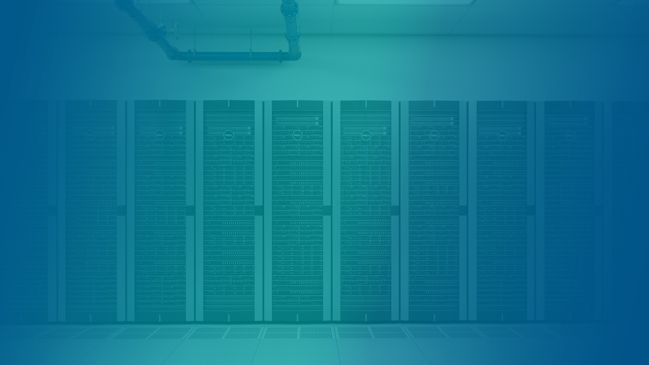
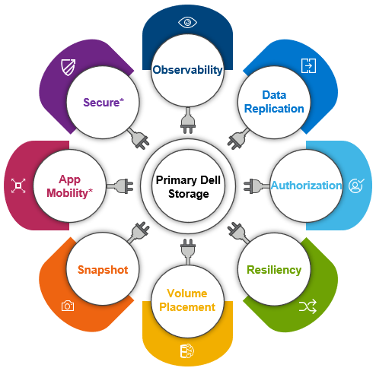
Data persistence, storage and protection for containerized workloads
CSI Plugins
Container Storage Modules
PowerProtect Data Manager
Storage interfaces built with the CSI standard specification
Software modules for storage management that go beyond CSI functionality
Application aware data protection and recovery with industry leading tools

Slide 20
Dell solutions for containerized workloads
Choose your preferred Kubernetes ecosystem
Dell has solutions for all 6 top commercial Kubernetes distributions
Azure Kubernetes Service
Data persistence, storage and protection
Deliver the right service levels and tools
CSI Plugins
Container Storage Modules
PowerProtect Data Manager

Slide 21
Storage for every Kubernetes workload
Direct block
VVOLs
File
Object
CSI Plugin
VMware CNS
CSI Plugin
Object Store API
Storage Volumes
vVols
NAS shares
Object end points
PowerFlex
HCI
PowerStore
Mid-range
PowerScale
Scale out NAS
ObjectScale
S3 Object Storage
PowerMax
High-end
Over 5 million downloads of PowerScale CSI Driver

Slide 22
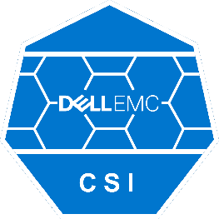
Single Kubernetes Operator
PowerMax
CSI Plugin
PowerStore*
CSI Plugin
PowerScale
CSI Plugin
PowerFlex
CSI Plugin
Unity XT
CSI Plugin
XtremIO
CSI Plugin
Single Operator to install and manage the lifecycles of all the plugins
*CSI Plugin for PowerStore will be part of the Operator in the near future.

Slide 23
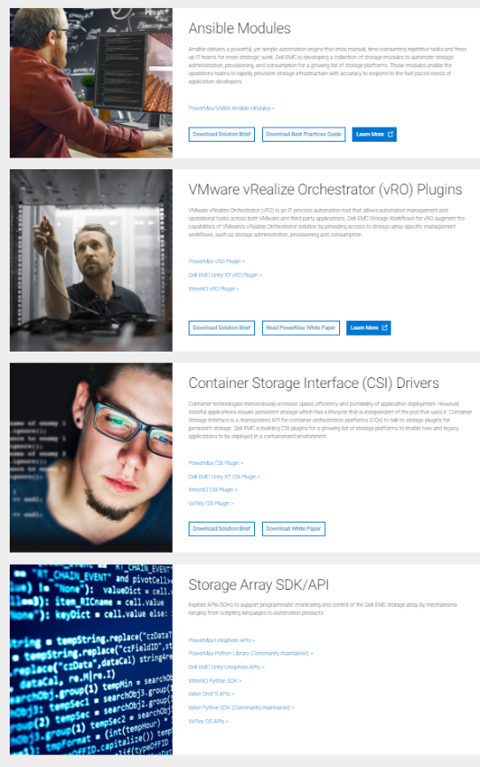
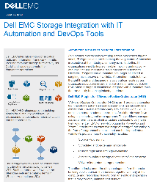
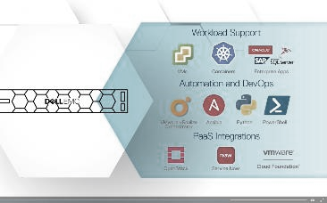
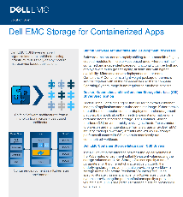
Resources
www.dellemc.com/storagesource

Slide 24
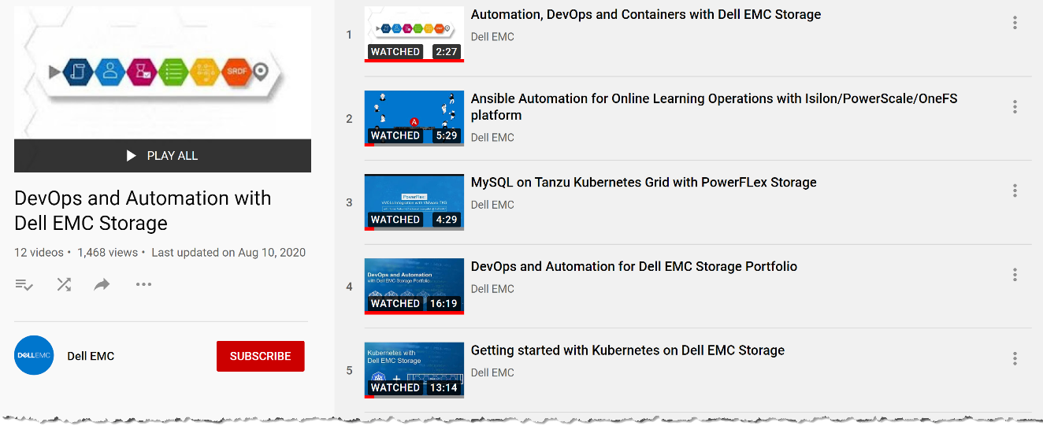
Demo Gallery on YouTube!
https://www.youtube.com/playlist?list=PLbssOJyyvHuVXyKi0c9Z7NLqBiDiwF1eA

Slide 25
Notes:
Thank you.

