Slide 1
Deploying AZ-aware cloud with OpenStack-Ansible
An Iver company
Notes:
Hello everybody,
Today I want to talk with you about Availability Zones and how actually to configure and deploy them. And most importantly — why worth doing that at the first place.

Slide 2
Who we are?
We Are OpenInfra!
An Iver company
Notes:
So, who we are?
(click)
We are openinfra! We all are!
And huge kudos to all of you for being part of it — as community is a very important fragment of any opensource project, as you and only you drive it ahead. And I am really honored to be part of such a great community.
Without further ado let me move to introduction part.

Slide 3
Dmitriy Rabotyagov
IRC: noonedeadpunk
OpenStack-Ansible Project Team Leader
OpenStack Technical Committee Member
Cloud Engineering Domain Leader @ Cleura
An Iver company
Notes:
(Click)
My name is Dmitiry.
I am Project Team Leader of OpenStack-Ansible, Member of Technical Committee and Domain Leader of Cloud Engineering at Cleura
What is Cleura you will ask.

Slide 4
Cleura,
the European cloud
PUBLIC CLOUD
Our public cloud can power any type of workload, whether container-based, serverless, or traditional. Use your favorite tools to automate. At the core, we offer global computing power, networking, and storage based on open source technologies which give you endless possibilities.
COMPLIANT CLOUD
Compliant Cloud is IT infrastructure with built-in regulatory compliance for industries regulated by specific laws, regulations or customer demands. It is a fully fledged IaaS for organisations who are required to store data in specific locations where auditability, traceability and dependability of physical and logical access is of particular importance.
PRIVATE CLOUD
Private Cloud from Cleura is a turnkey solution for anyone in need of a complete OpenStack-based cloud. We build your cloud, based on your specific needs, from the ground up and hand over the keys to your very own cloud management system. Depending on your needs, we can manage your private cloud allowing you to focus on allocating resources from your very own managed private cloud.
ISO CERTIFIED
Infromation security: ISO 27001, 27010, 27013, 27017, 27018
Resilience: ISO 22301
Environmental management: ISO 14001
Quality Assurance: ISO 9001
Only in Public cloud we currently manage:
6 regions
60TB of RAM
4500 CPU cores
5.88 PB of storage
An Iver company
Notes:
Well, Cleura, previously named as CityNetwork, is the European cloud with headquarter in Sweden.
We provide bunch of different services, including Public, Compliant and Private clouds.
We are certified according to ISO standards in information security, resilience, environmental protection and quality assurance.
At the moment of speaking we manage 6 public regions all over the globe, including EU, US, Japan and middle-east with 60TB of RAM, over 4500 CPU cores and almost 6 PB of storage.
I’m not really allowed to disclose statistics about compliant or private clouds, but believe me it will be quite solid extra to these numbers, given that complience is in high demand nowadays.

Slide 5
Why we started looking at Availability Zones?
Improve resiliency and redundancy
Use isolated fire rooms (or datacenters)
Provide common API for managing resources
Customer requests
An Iver company
Notes:
If you was ever using our public cloud you might have noticed, that we have «nothing shared» concept in our regions. This means that regions are completely standalone and don’t have any dependencies on each other. So why we started looking into Availability Zones?
Well, first of all we wanted to improve resilience. That also includes doing Maintenances. For example upgrading network nodes or computes in AZ1 won’t anyhow affect clients in AZ2.
Next we wanted to spread region into multiple datacenters with not less then 10km distance between them. It is not only improve resilience in case of site-wise power outages or fires but also an ISO 22301 requirement.
Another requirement was that most popular toolings, like openstackclient, terraform or ansible should work seemlesly with our regions. We truly believe in openstack interoperability – that any user who comes from any other openstack provider should feel like home.
And yes. We were actually asked by our customers to introduce availability zones to our regions. And we can’t dissapoint customers, right?

Slide 6
Designing Availability Zones
An Iver company
Notes:
With that we slowly moving to Availability zone design questions. And it’s quite a topic on itself. As every organization does have it’s own requirements and vision on how Availability zones should look and act like.

Slide 7
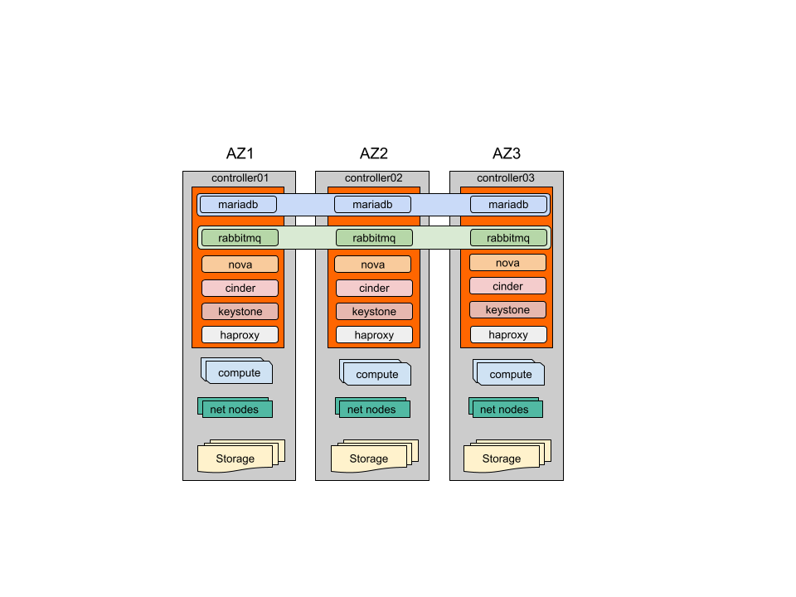
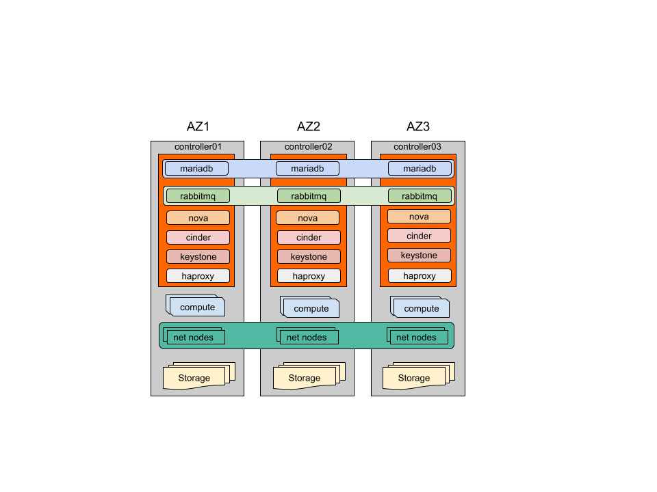
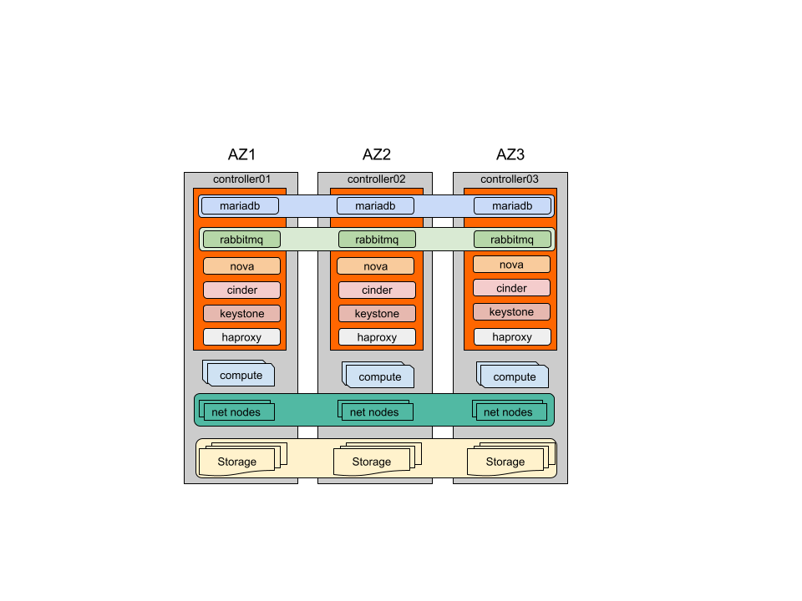
Basic architecure
In Each Availability Zone we have:
Member of Galera Cluster
Member of RabbitMQ Cluster
API backends of OpenStack services
Loadbalancer
Hypervisors
Network nodes
Storage
You can share networks or storage between AZs if needed
An Iver company
Notes:
So we ended up with having 3AZs per region. Mostly, because 3 is a good number for quorums. And it’s not only about quorums for internal infrastructure but it is also about customer deployments that will run in the region.
Each AZ have MariaDB and RabbitMQ cluster members. Then we have a copy of each OpenStack API service that is behind a loadbalancer. All of them are placed on a control plane and we have 1 control plane per AZ.
Then we have set of independant compute, network and storage nodes.
(click)
Eventually, you can share storage or tenant networks between availability zones. But as I said previously it highly depends on requirements you have and tradeoffs you are ready to accept. Geographical location of AZs and basically link cost between them are another factors. Simple example — in case of 20km distance between AZs you will already see an increased latency for storage — unfrotunatelly nobody has cancelled speed of light yet, so we need to deal with it.

Slide 8
When to consider Availability Zones?
AZ can help you if:
You want to share resources between AZs (like networking or storage)
Distance between regions is small enough and conenction is fast and cheap
It is business or customer requirement
What AZ won’t do:
Improve OpenStack control plane resilience
Scale out load from rabbitmq or galera
Not all OpenStack Services support AZs
An Iver company
Notes:
So based on the mentioned design we already can say couple of words about Availability Zones.
AZ is a valid choice if you want or need to stretch tenant networks and/or storage between them. But it actually is possible only when connection between AZs is fast, reliable and cheap.
However, you can workaround networks sharing in another way — using VPNaaS. But no toolings I mentioned before can work with that. Also you won’t be able to failover floating IP between AZ so it’s not really convenient.
At the same time as we need to stretch RabbitMQ cluster and MariaDB cross-AZ, we don’t really improve OpenStack API resilience. For example, if smth goes wrong with rabbitmq or database, whole region will be affected.
And that obviously does not solve potential scaling issues of clusters.
It also worth mentioning that limited amount of services do support AZs and can schedule resource creation cross-AZ. As simple example — Octavia does not as of today.

Slide 9
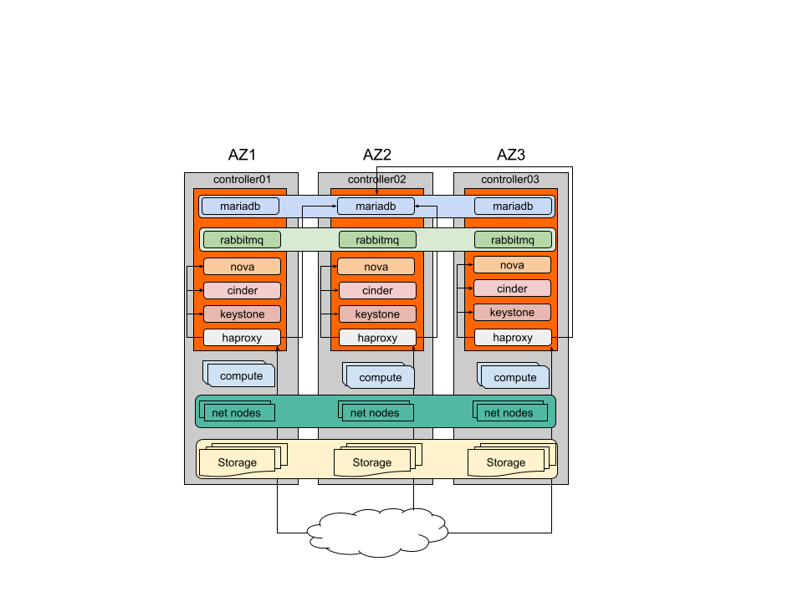
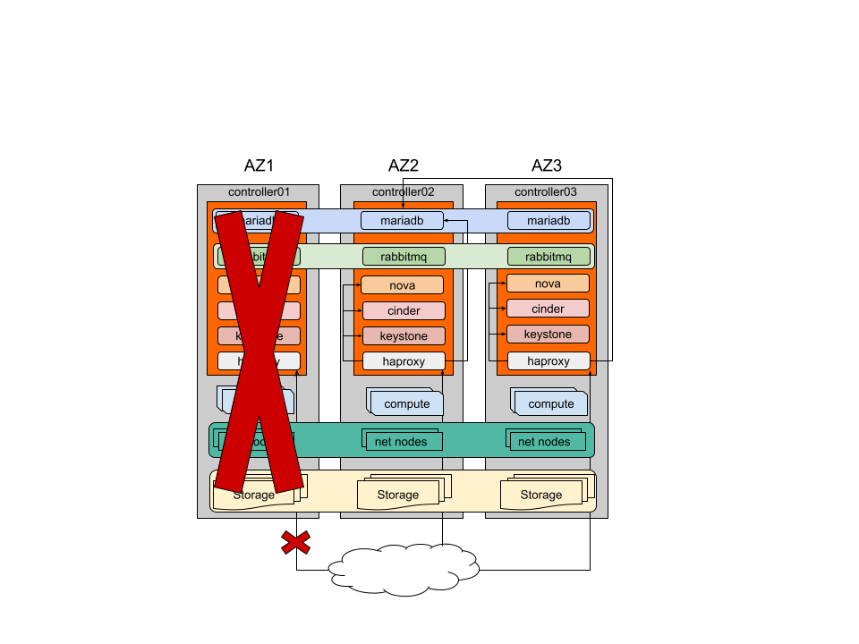
Redundancy of services
To reduce traffice between AZs, loadbalancer does prefer passing traffic to the backends in it’s own AZ
In case of backend outage in AZ, balancer will pass traffic to other AZs
In case of AZ being fully unavailable API will remain functional.
Neutron agents can failover if tenant networks are shared
An Iver company
Notes:
Now let’s see if our solution is redundant and can survive in this tough and unpredictable world.
(click)
As you might have noticed, there was slight update to the previous 2 pictures. So each loadbalancer recieve incoming requests and pass them only to the local API endpoints.
But what will happen if some service dies?
(click)
Well, loadbalancer will adopt and forward traffic to any other AZ where service is still alive.
And what if AZ will be fully unavailable?
Well
(click)
In short - it won’t pass unnoticed. While API resume working as rest loadbalancers will still recieve requests, customer workloads placed in affected AZ won’t be functional. It depends how bad that would be though.
If storage is shared — you will be able to spawn workloads in other AZ with couple of hacks, given you have capacity of course.
If tenant networks are shared — routers can be spawn cross-Az, so they will failover automatically in case of incident and floating IPs resume working

Slide 10
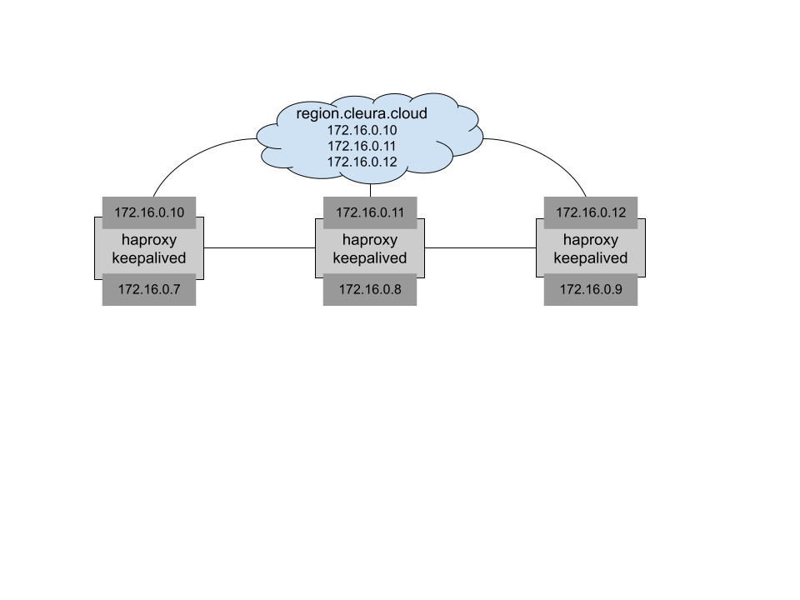
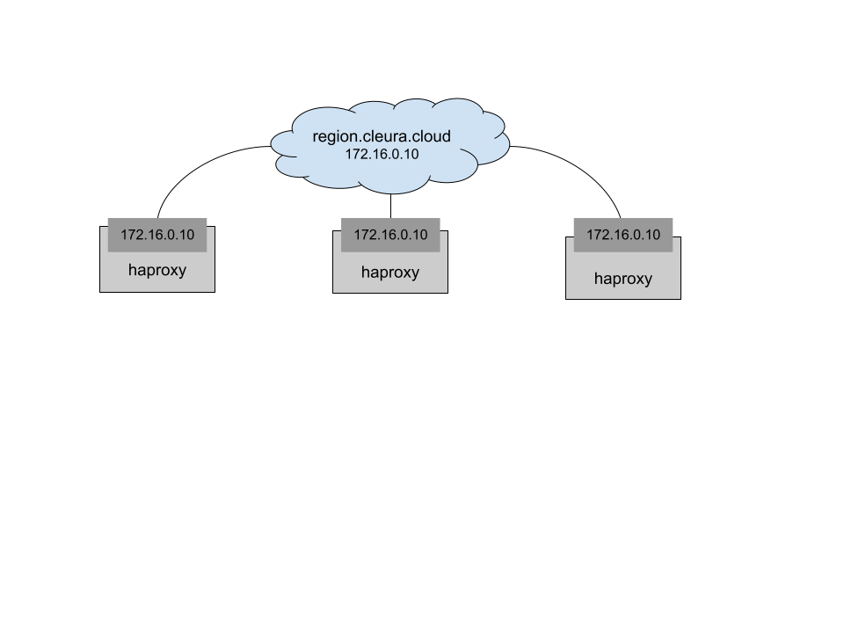
Balancing incoming requests
Using anycast
Implemented on infrastructural level
Makes limited sense if AZs are too close to each other
Using VRRP
Implemented on loadbalancers
Requires L3 connection between AZs
An Iver company
Notes:
So how we made all loadbalancers to be active and accept incoming requests.
At very least there’re two options.
(click)
First one is Anycast. With it you have same IP assigned to the interface on all 3 controllers that is being announced from your core router. And client will reach closest AZ. Anycast is usually used in geographically distant regions. It can still be used for AZs that are located in the same datacenter but it might have more limited sense to use it.
(click)
Another option is DNS RR balancing and VRRP.
So you define 3 A DNS records for the region FQDN. Then, each of these IPs are brought up on different loadbalancer nodes. Client will resolve DNS to a different IP randomly and reach one of the AZs
But in case of AZ outage one of DNS records will point to a frontend that is not reachable anymore. SO 1/3 of client requests will fail.
And here VRRP steps in. It uses multicast or unicast for communication, thus requires L3 connection between Azs. In case of incident with loadbalancer VRRP will bring up it’s IP on another AZ.

Slide 11
Deploying Availability Zones
An Iver company
Notes:
Once we have figured out the design, it’s time to make it real. Which brings us to the second part of the talk that will be about deployment and it’s automation.

Slide 12
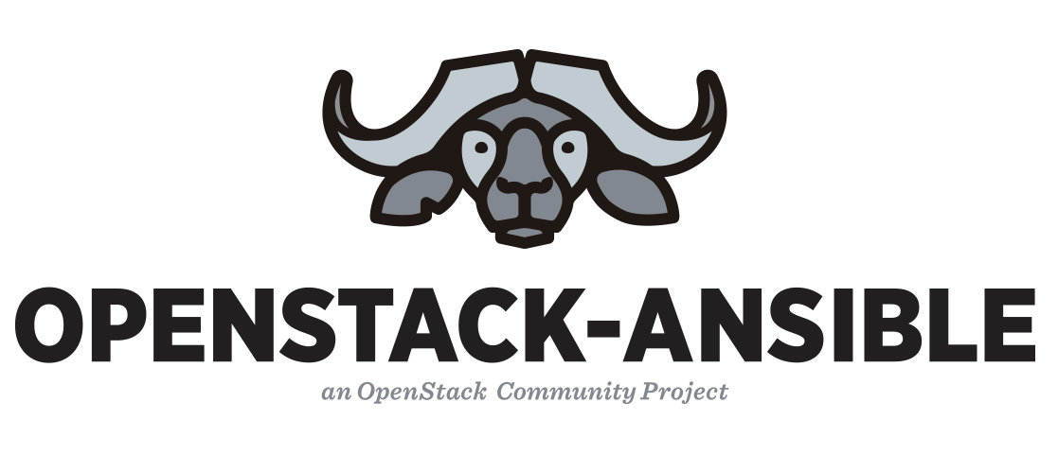
Automating deployment?
OpenStack-Ansible!
We use OpenStack-Ansible as our daily driver to deploy, configure and upgrade all our regions.
We not only consume OpenStack-Ansible, but also actively contribute back our findings, including new use-cases, bug fixes and various improvements of deployment and upgrade workflow.
We feel confident to run playbooks anytime we need to implement configuration chage or restore service to it’s desired state as Ansible is idempotent by design.
An Iver company
Notes:
(text on the slide)
Say it’s official project, so opensource, free etc
We started using osa when were running ubuntu 16.04 and OpenStack Rocky. Now we’re on 20.04 and Xena. And these upgrades went really well for us. We’re going to upgrade all our regions to Ubuntu 22.04 and Antelope during next year.

Slide 13
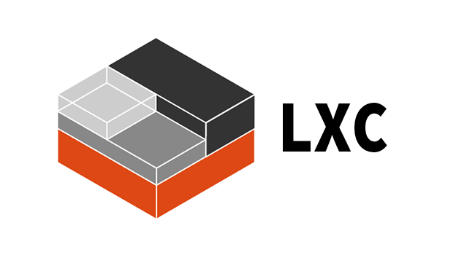
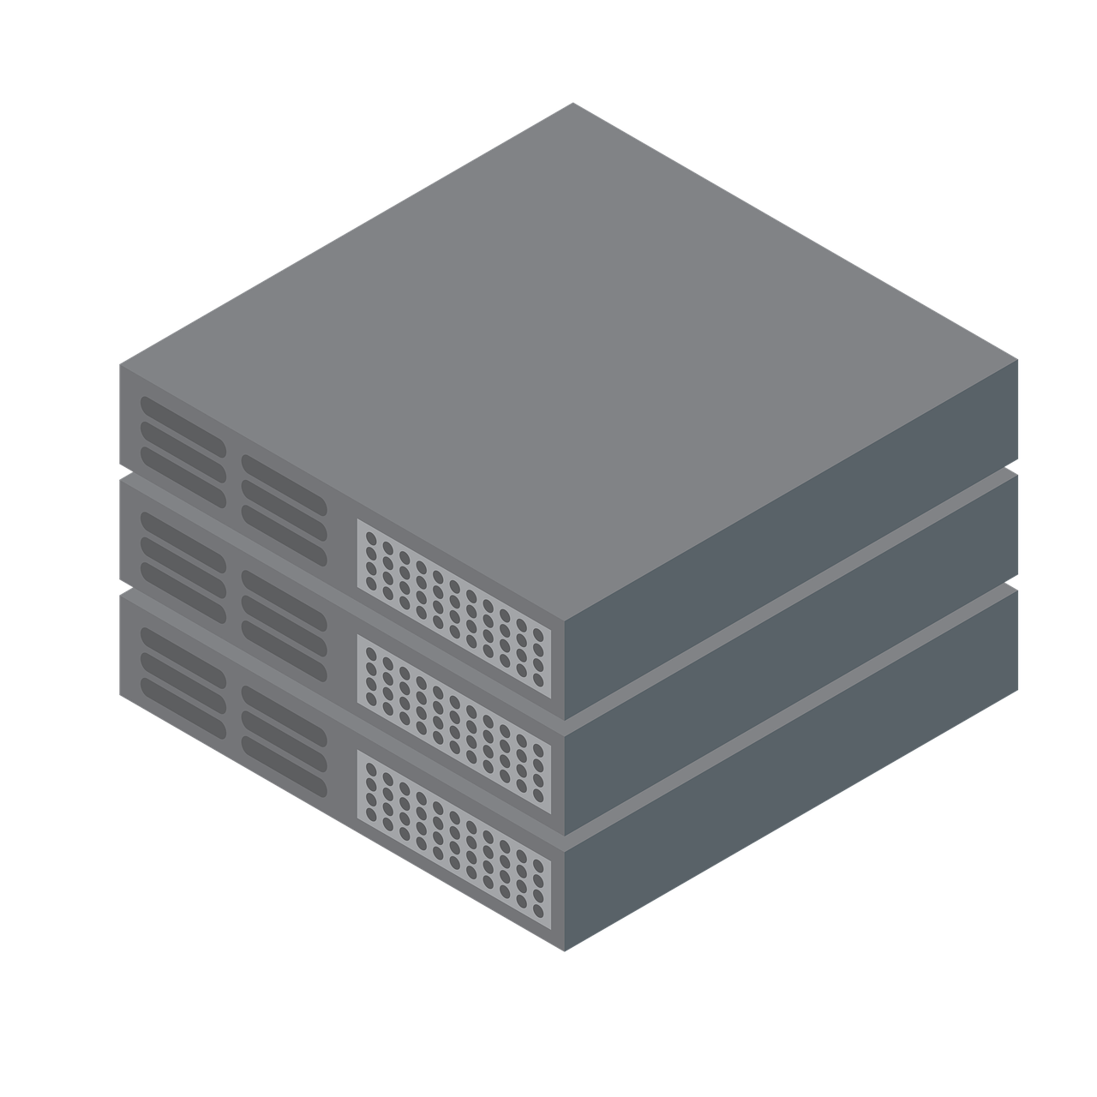
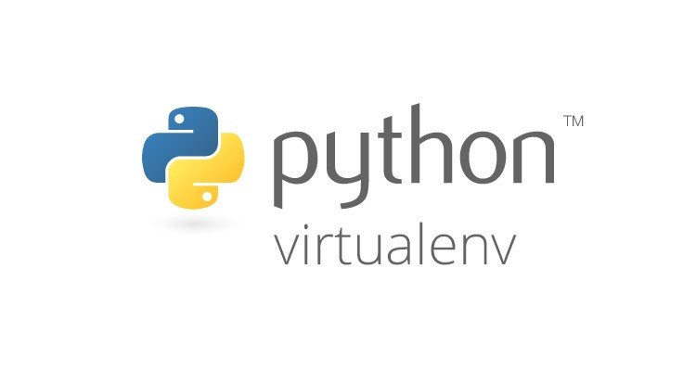
OpenStack-Ansible is flexible,
thus powerful!
Can deploy:
In LXC containers
On bare metal
Install services:
In virtualenvs
With distro packages
Operating systems:
Ubuntu
Debian
CentOS Stream
Rocky Linux
An Iver company
Notes:
Can deploy lxc/metal
(click)
venv/packages
(click)
ubuntu/debian/centos/rocky

Slide 14
Configuring OpenStack-Ansible
An Iver company
Notes:
So lets’ have some deeper dive into OSA configration to get our AZ live.

Slide 15
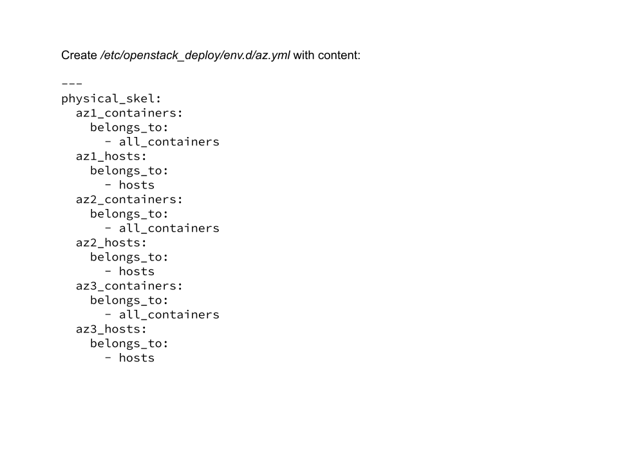
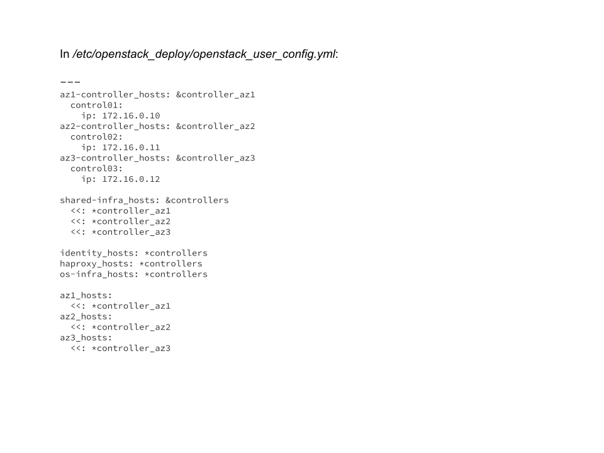
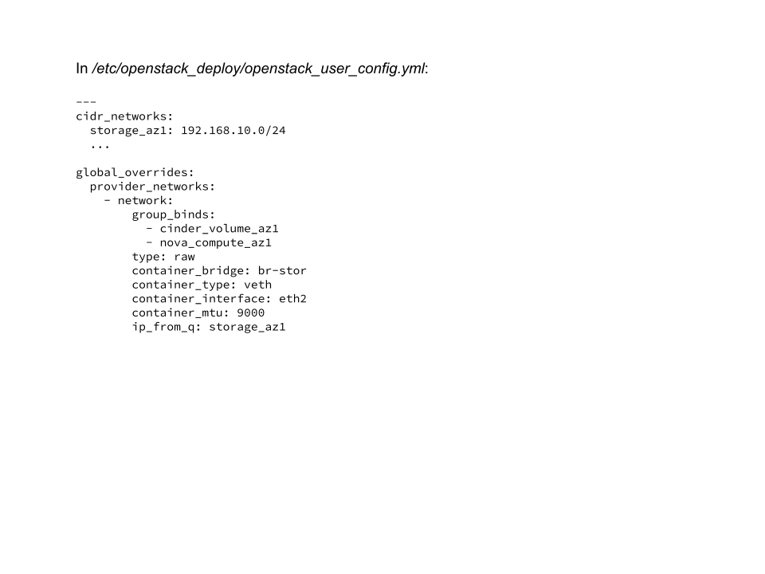
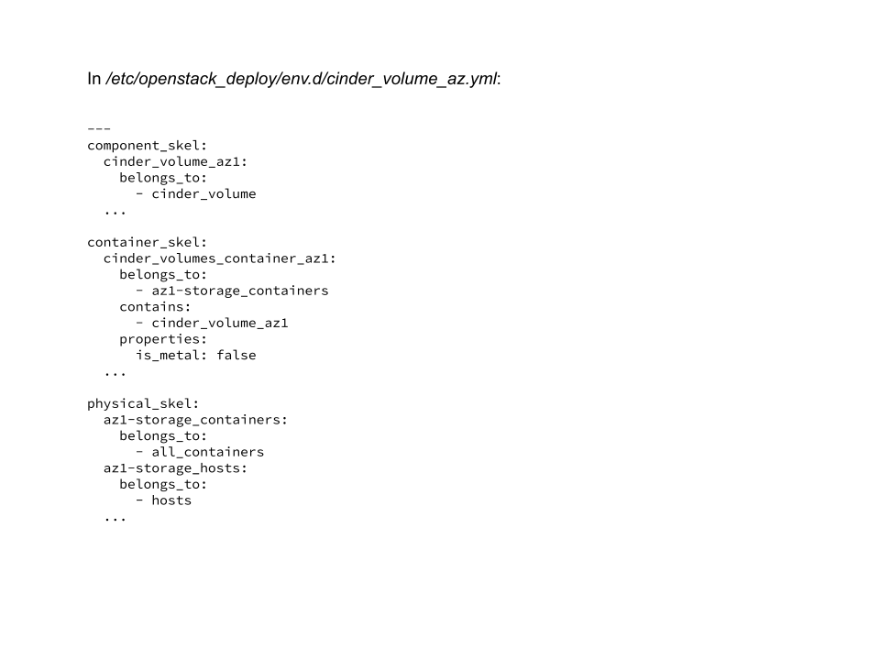
Playing with inventory
Define Availability Zones as groups
We need to have AZ specific groups. All services, that will be deployed inside AZ will be children of this group.
Map hosts to AZ groups
Now we can use these groups and add hosts to it.
This way we tell dynamic_inventory, that we want to deploy openstack services and infrastructure on all 3 controllers, but add each controller with all it’s children to appropriate AZ group.
Use AZ-specific networks if needed
In case you do not share storage between Availability Zones you will need to add more storage networks to the deployment.
For that define these networks and map them to defined groups.
You can also define extra groups for these networks
As simple example – you might need to have multiple independent sets of cinder-volume services, as only cinder-volume in current AZ can reach and manage storage.
An Iver company
Notes:
And let’s start with defining inventory. Being flexible brings not only power, but sometimes also complexity. And how to correctly define inventory is probably most complex things in OpenStack-Ansible. To have that said — you can just use static inventory and don’t bother yourself with dynamic one, but I personally still prefer dynamic.
(click)
So first of all let’s define a group for each AZ. It’s handy, because you can define variables as group_vars, so they will apply to all hosts in the group.
(click)
Next, let’s map our controllers, infra and openstack services to Azs. If it’s deployment with LXC containers they will also appear under AZ groups.
(click)
If your storage is available only in specific AZ — you will need to spawn set of cinder-volume services in each AZ. And likely storage will have a unique networks in each AZ. So you need to make sure that these networks are defined and passed to the cinder-volume containers.
(click)
And you then also need to create a cinder-volumes group per AZ then.

Slide 16
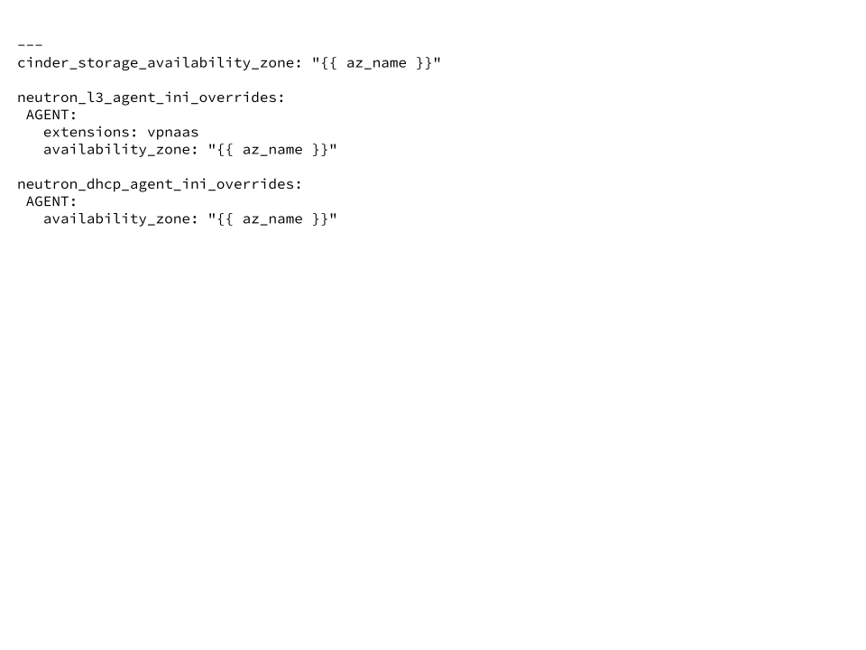
Configuring variables
Define Availability Zone name under group_vars/az1_all
Define required overrides under user_variables.yml
An Iver company
Notes:
Once we have groups defined, we can finally leverage group_variables and define availability zone names
(click)
Then az_name variable can be used to apply overrides properly for services across all hosts.
As you might noticed, nova is not in the list. It’s because you define availability zone for nova when assigning host to aggregate and aggregate is assigned to AZ. At the moment OpenStack-Ansible does not create or manage aggregates but we have plans to add this functionality quite soon.

Slide 17
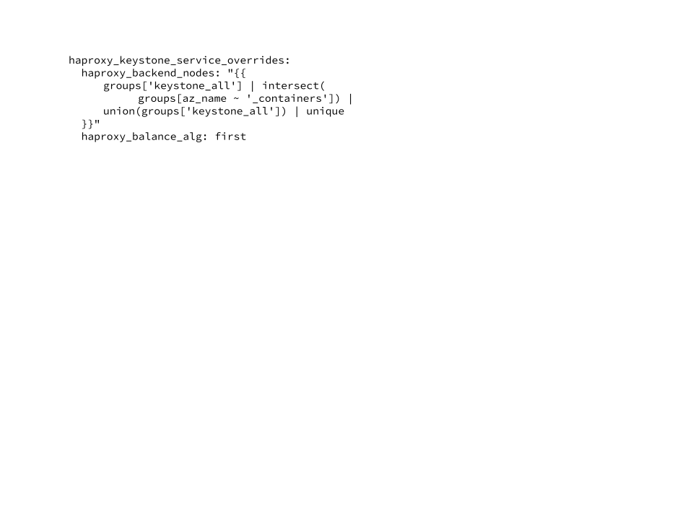
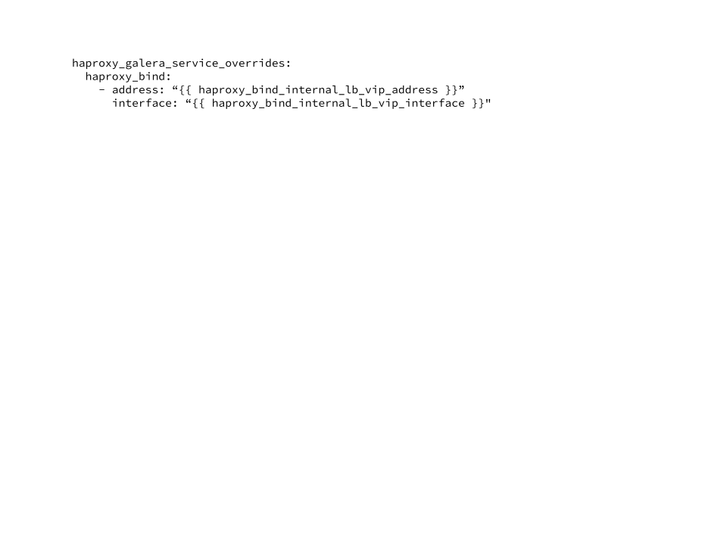
Configuring LoadBalancer
Listen on interfaces instead of IP addresses
Use backend in own AZ first, fallback to others when required
Use central backend for some services (like mariadb)
An Iver company
Notes:
And finally time has come to loadbalancer configuration. OpenStack-Ansible does deploy and manage haproxy as a loadbalancer. We can make configuration quite independant of approach we’ve chosen. So this will be applicable for both Anycast and DNS RR with VRRP.
(click)
For that, we will bind haproxy not to specific IP but to the interface. So regardless of the Ips on the interfaces, traffic will be served.
(click)
Next, we need to sort backends in proper order, so that the one, that is in the same AZ as the loadbalaner was listed as the first one. We also overwrite balancing algorythm to be first instead of leastconn because we want to leave traffic inside AZ but be able to failover if smth goes wrong.
(click)
And last step is to adjust bind option for internal services, like mariadb. That’s due to default values that differ for not externaly exposed services.

Slide 18
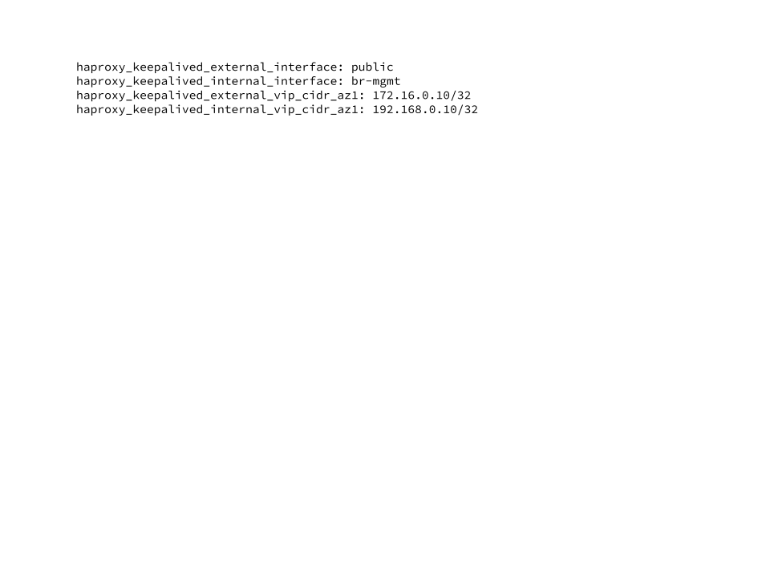
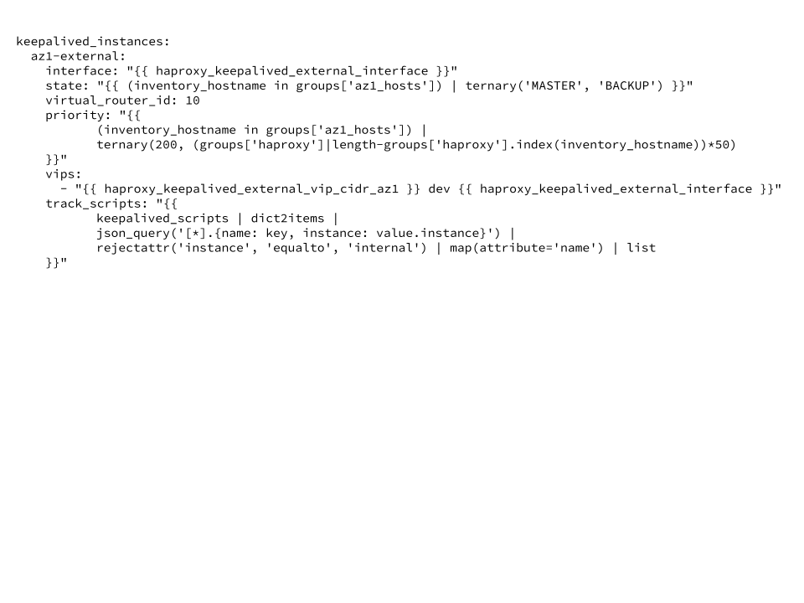
Configuring VRRP for DNS RR
Define interfaces which will be used for Keepalived communication and IP addresses that will be spawned on them by keepalived
Define keepalived VRRP instances
An Iver company
Notes:
And very last slide might be useful for those who decided to use VRRP.
OpenStack-Ansible can install and manage keepalived. And it’s default behaviour even without availability zones. But in order to configure it according to our design, we need to apply some tricky overrides.
(click)
First is easy — alike with haproxy we define IP addresses and interfaces that will be configured as virtual Ips for each AZ.
(click)
And next thing is really tricky. Here we’re defining 2 VRRP instances for each AZ — for public and management networks. They’re really same in idea of what needs to be done though.
So we are defining state, based on the group to which current host belongs to — if it’s in the current AZ — it will be master or BACKUP otherwise.
And we also calculate weight based on the group — we set 200 if it’s in current AZ and then lower numbers for other Azs. That is important, as keepalived checks deduct weight when failing. When weight goes lower then other instances — virtual ip will be moved to that instance.
Track_scripts value is default here, but it should be mentioned as we’re overriding whole structure here.
.

Slide 19
Thank you! Questions?
IRC: #openstack-ansible on OFTC
Documentation:
Check our website:
An Iver company

